Slide 1
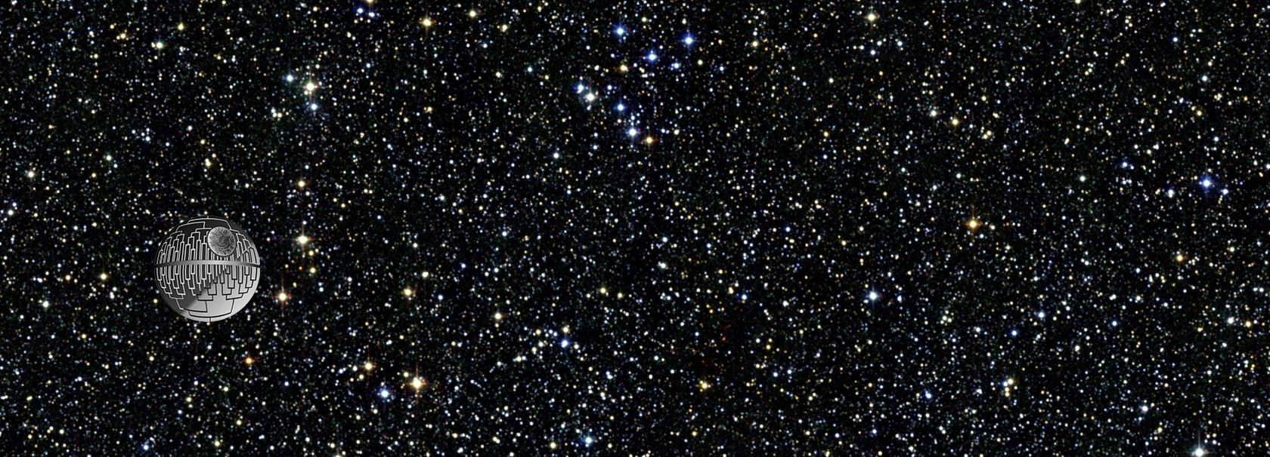
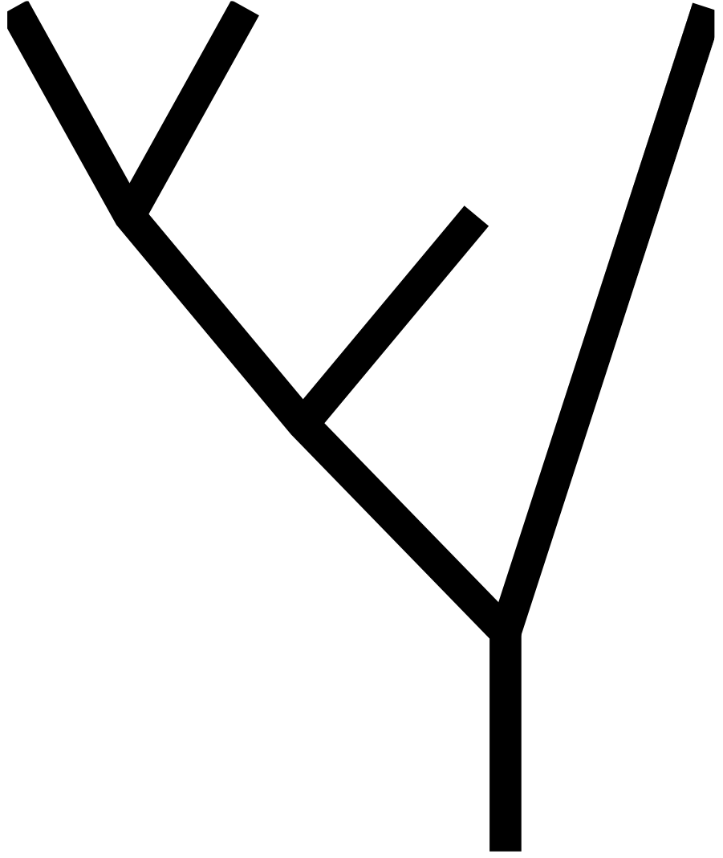
Phylo Seminar 2024

Slide 2
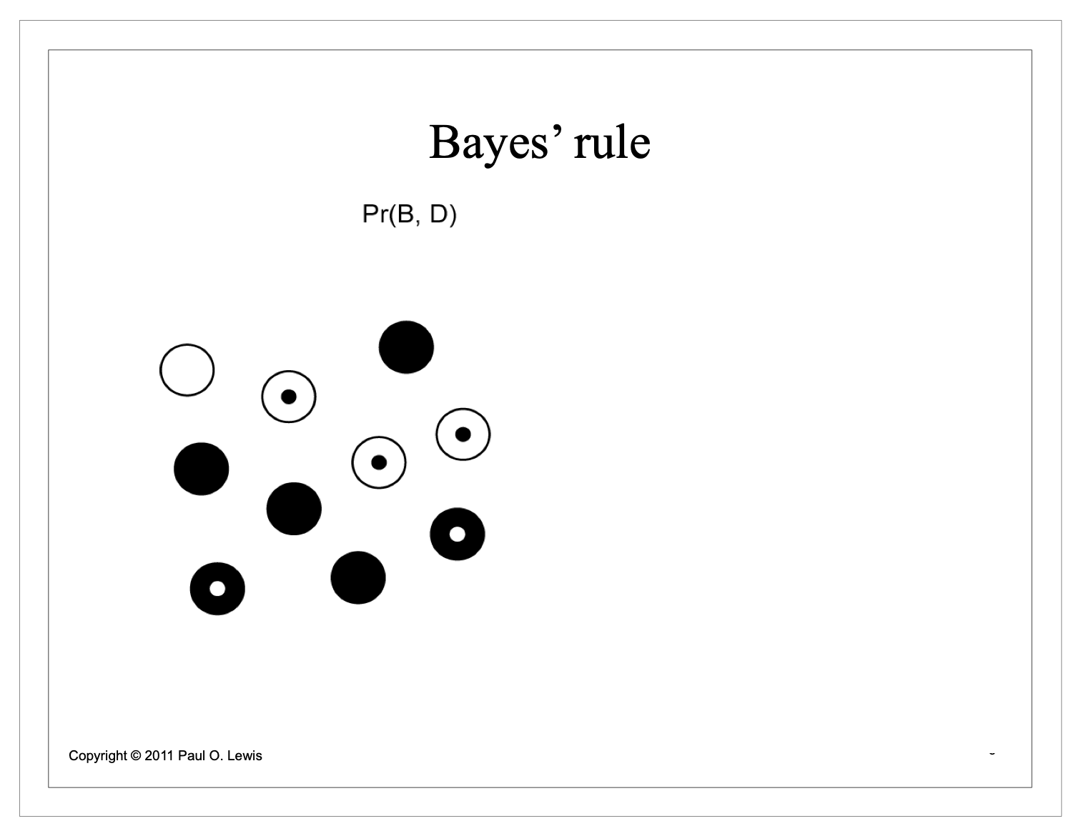
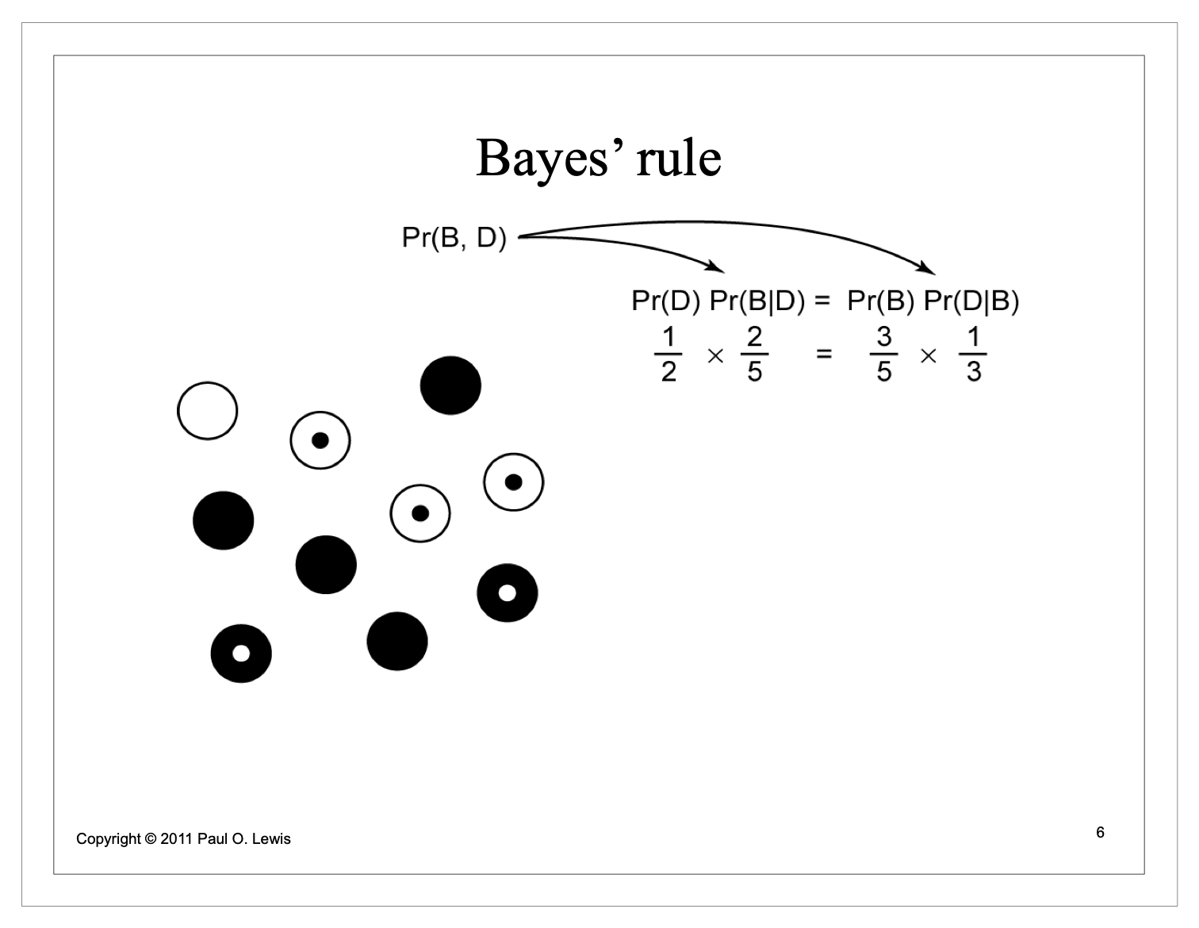
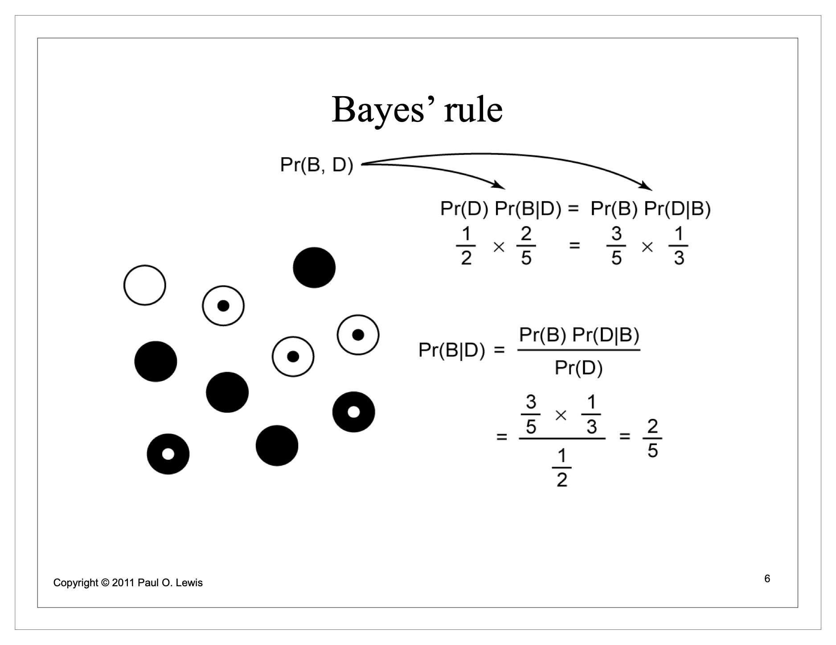
What is this Bayes’ theorem black magic?

Slide 3
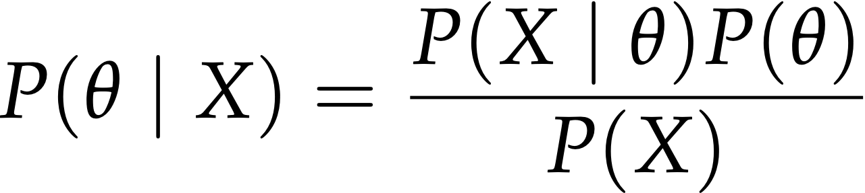
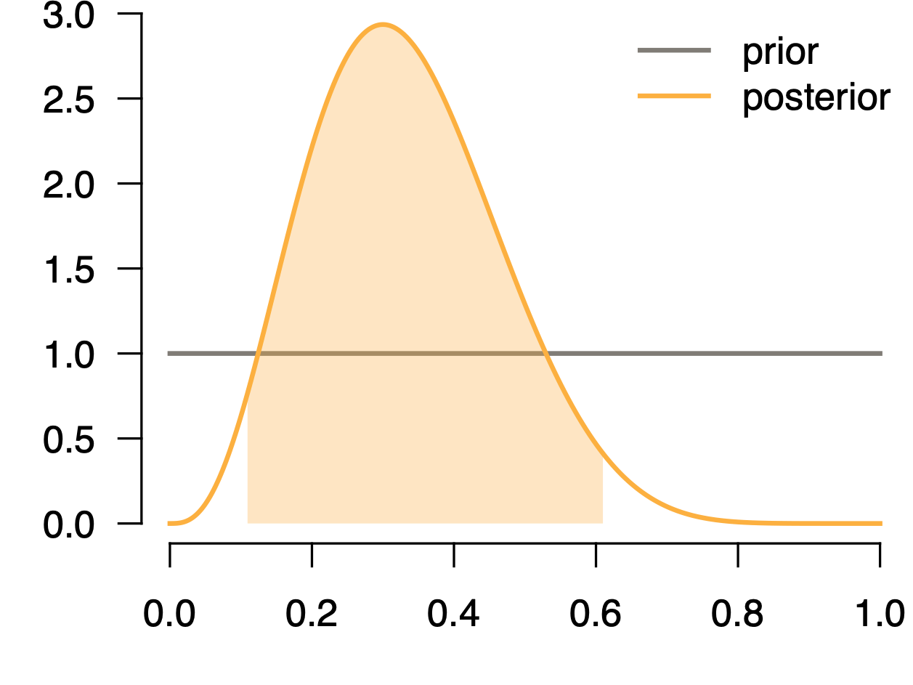
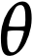
Bayesian Inference
Bayesian Inference
… into our posterior belief about the relative plausibility of different parameter values.
We’re not just interested in the peak of this distribution, but also the uncertainty around it.
posterior
95% credible interval
probability density
Slides courtesy of Mike May

Slide 4
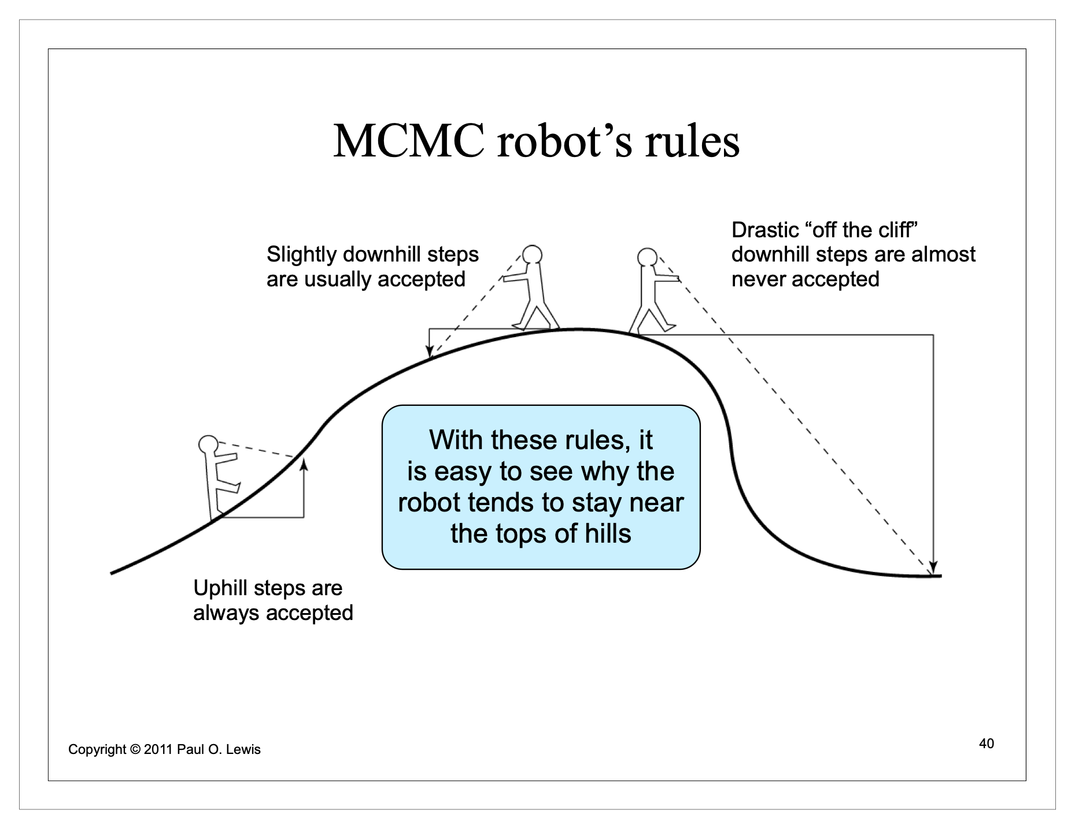
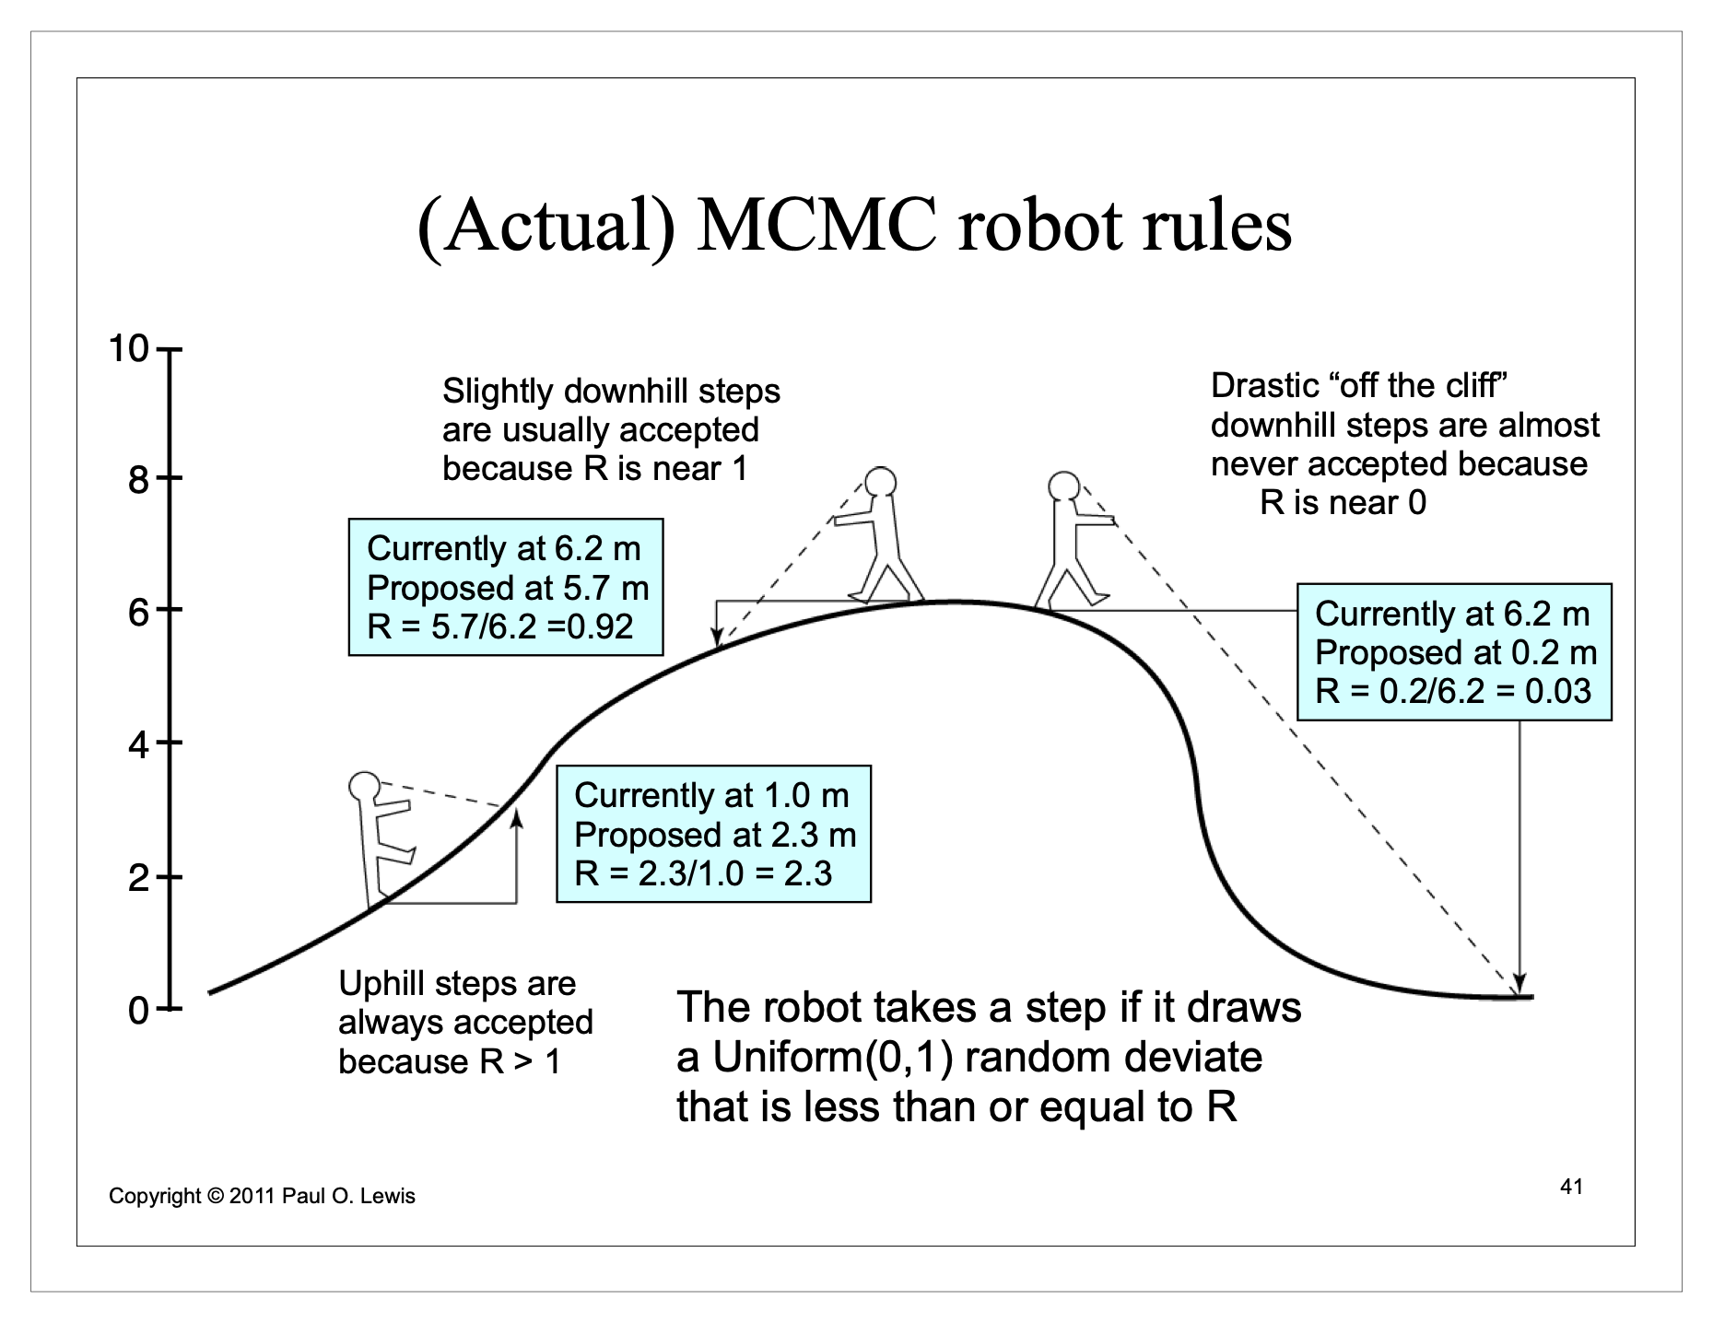
MCMC
Instead of calculating it, MCMC infers the posterior distribution by sampling it

Slide 5
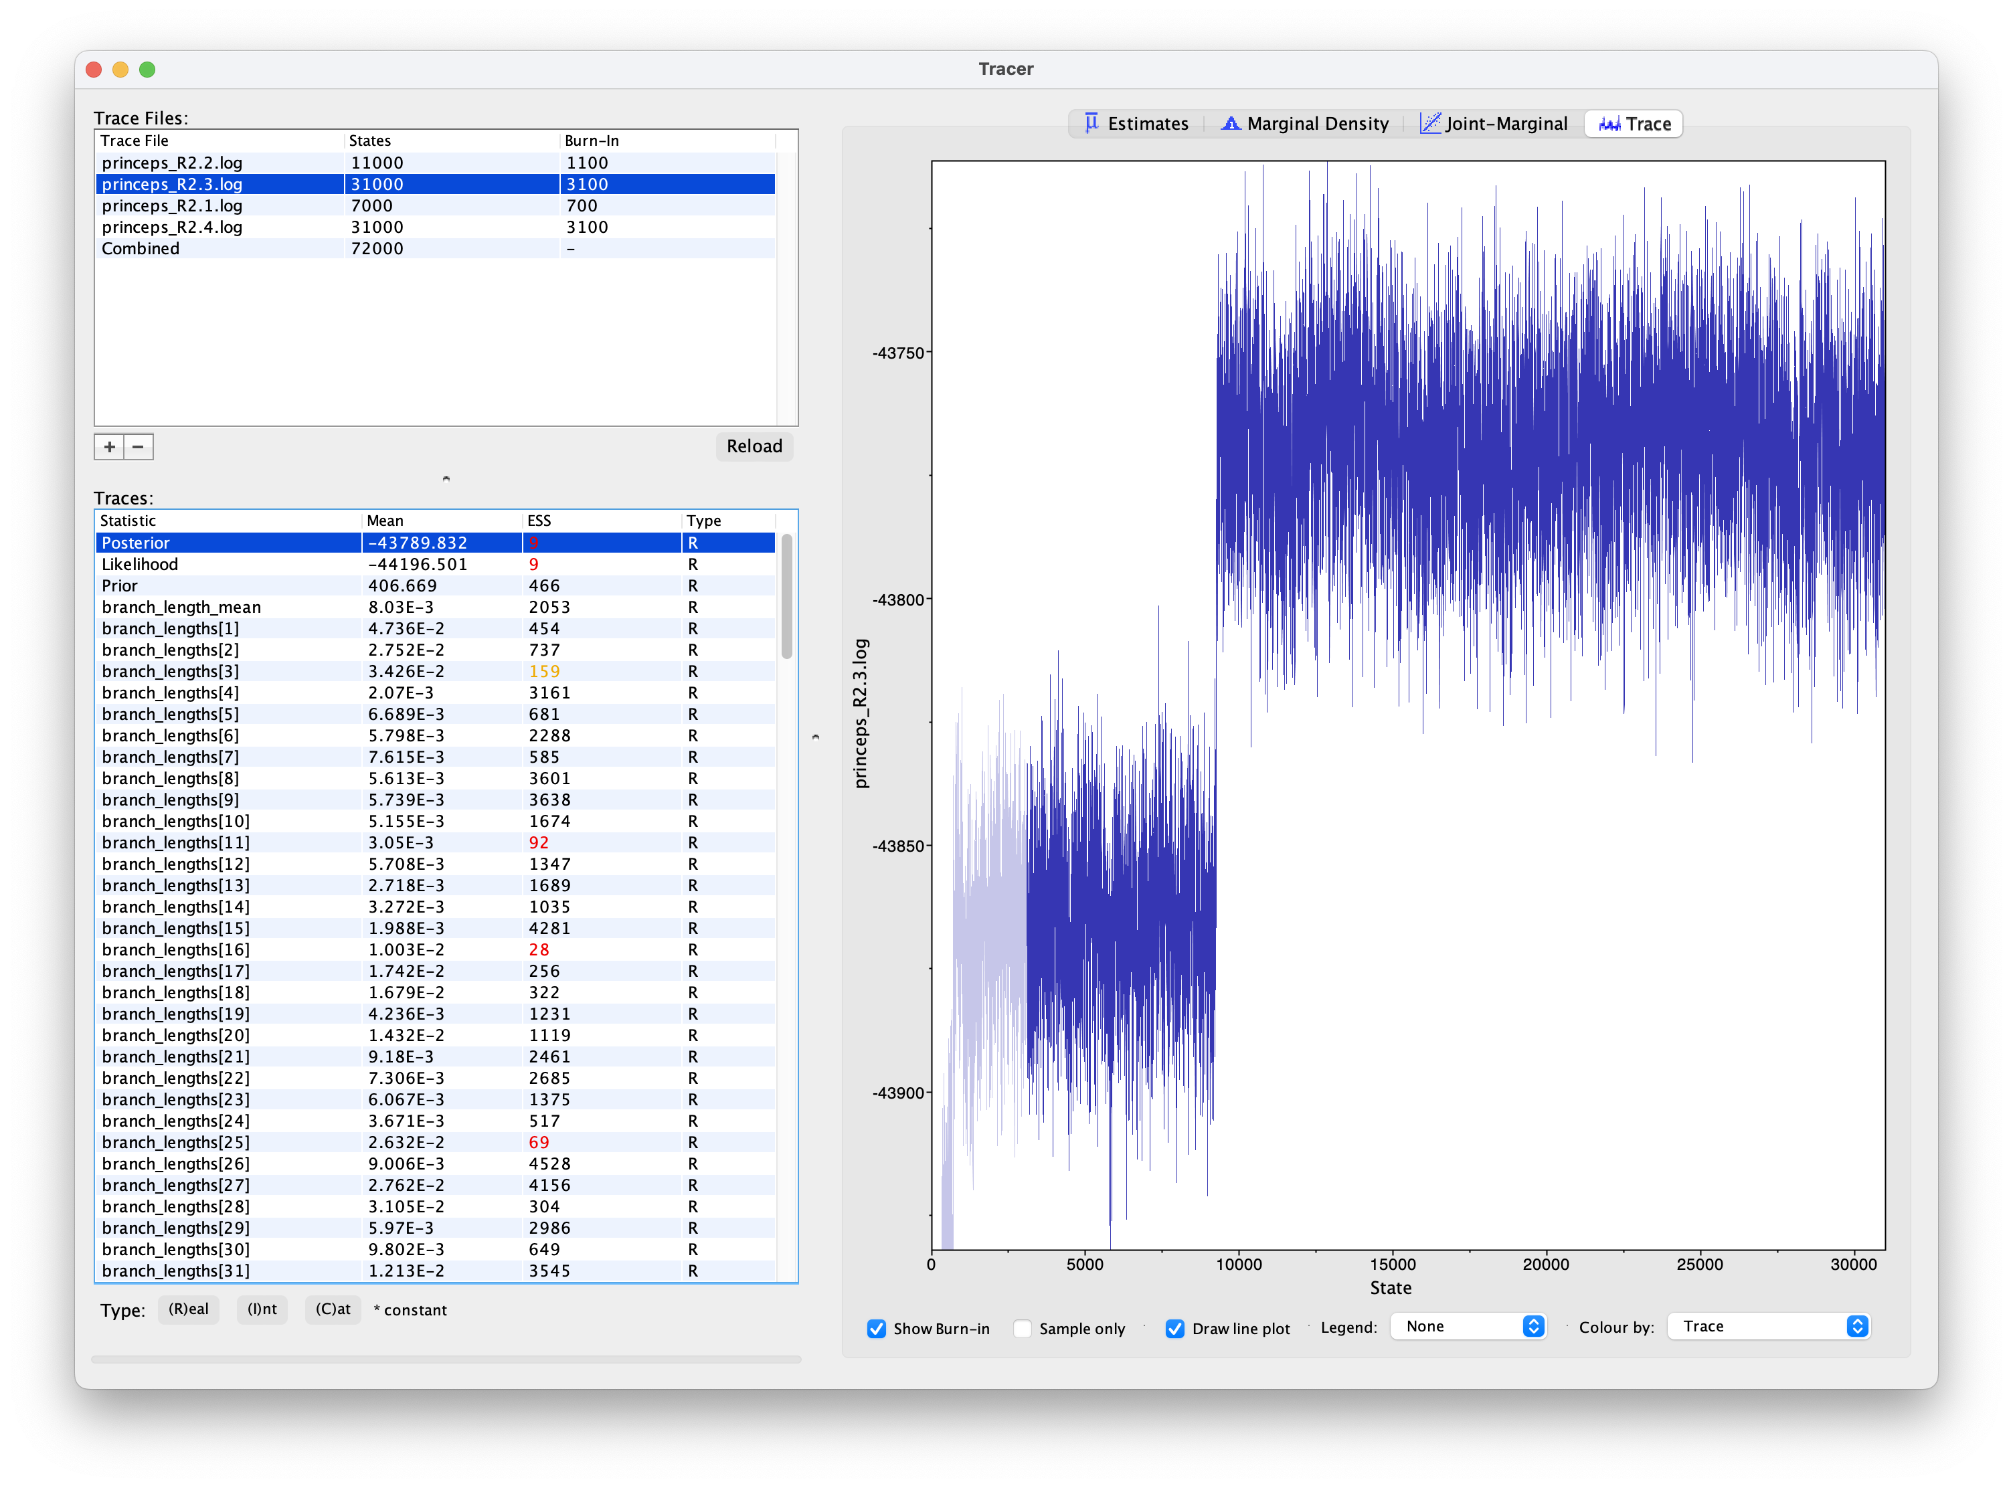
“Convergence”

Slide 6
Bayesian inference of phylogeny
Nitty gritty: BI vs ML
What are the main differences between BI and ML? Both are “model based” and rely heavily on likelihood, so…
BI requires priors!
BI infers the probability of the model (the parameter values) given the data, rather than the other way around
BI infers a distribution; ML provides a point estimate
BI is computationally demanding
BI can be used with models that are too complicated for ML

Slide 7
Bayesian inference of phylogeny
Nitty gritty: BI vs ML
What are the main differences between BI and ML? Both are “model based” and rely heavily on likelihood, so…
BI requires priors!
BI infers the probability of the model (the parameter values) given the data, rather than the other way around
BI infers a distribution; ML provides a point estimate
BI is computationally demanding
BI can be used with models that are too complicated for ML

Slide 8
Bayesian inference of phylogeny
Nitty gritty: BI vs ML
What are the main differences between BI and ML? Both are “model based” and rely heavily on likelihood, so…
BI requires priors!
BI infers the probability of the model (the parameter values) given the data, rather than the other way around
BI infers a distribution; ML provides a point estimate
BI is computationally demanding
BI can be used with models that are too complicated for ML

Slide 9
Bayesian inference of phylogeny
Nitty gritty: BI vs ML
What are the main differences between BI and ML? Both are “model based” and rely heavily on likelihood, so…
BI requires priors!
BI infers the probability of the model (the parameter values) given the data, rather than the other way around
BI infers a distribution; ML provides a point estimate
BI is computationally demanding
BI can be used with models that are too complicated for ML

Slide 10
Bayesian inference of phylogeny
Nitty gritty: BI vs ML
What are the main differences between BI and ML? Both are “model based” and rely heavily on likelihood, so…
BI requires priors!
BI infers the probability of the model (the parameter values) given the data, rather than the other way around
BI infers a distribution; ML provides a point estimate
BI is computationally demanding
BI can be used with models that are too complicated for ML

Slide 11
Bayesian inference of phylogeny
Nitty gritty: BI vs ML
What are the main differences between BI and ML? Both are “model based” and rely heavily on likelihood, so…
BI requires priors!
BI infers the probability of the model (the parameter values) given the data, rather than the other way around
BI infers a distribution; ML provides a point estimate
BI is computationally demanding
BI can be used with models that are too complicated for ML

Slide 12
Should we believe our phylogeny?
Phylogenetic support values, etc

Slide 13
Support values
For distance, parsimony, and likelihood approaches
Every tree is an estimate. So we need a way to know how confident we should be in that estimate. We have the best tree, according to some criterion, but it is much better than the next best tree, etc?
Topology tests (how much better is the best tree that contains a clade than the best tree that doesn’t?) (Doesn’t work for distance methods)
(Nonparametric) bootstrapping
How is this done? (What is a bootstrap dataset?)
How is bootstrapping information summarized/used? (Consensus tree..)

Slide 14
Support values
For distance, parsimony, and likelihood approaches
Every tree is an estimate. So we need a way to know how confident we should be in that estimate. We have the best tree, according to some criterion, but it is much better than the next best tree, etc?
Topology tests (how much better is the best tree that contains a clade than the best tree that doesn’t?) (Doesn’t work for distance methods)
(Nonparametric) bootstrapping
How is this done? (What is a bootstrap dataset?)
How is bootstrapping information summarized/used? (Consensus tree..)

Slide 15
Support values
For distance, parsimony, and likelihood approaches
Every tree is an estimate. So we need a way to know how confident we should be in that estimate. We have the best tree, according to some criterion, but it is much better than the next best tree, etc?
Topology tests (how much better is the best tree that contains a clade than the best tree that doesn’t?) (Doesn’t work for distance methods)
(Nonparametric) bootstrapping
How is this done? (What is a bootstrap dataset?)
How is bootstrapping information summarized/used? (Consensus tree..)

Slide 16
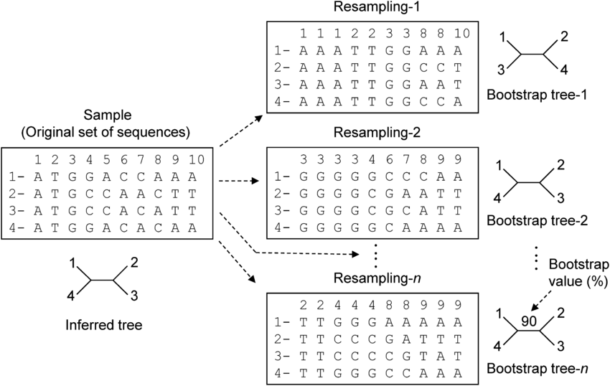
Support values
For distance, parsimony, and likelihood approaches
Every tree is an estimate. So we need a way to know how confident we should be in that estimate. We have the best tree, according to some criterion, but it is much better than the next best tree, etc?
Topology tests (how much better is the best tree that contains a clade than the best tree that doesn’t?) (Doesn’t work for distance methods)
(Nonparametric) bootstrapping
How is this done? (What is a bootstrap dataset?)
How is bootstrapping information summarized/used? (Consensus tree..)
Image from Ateto 2014, in Molecular Biology, Genes, Genome, Databases and Analytical Tools.

Slide 17
Support values
For distance, parsimony, and likelihood approaches
Every tree is an estimate. So we need a way to know how confident we should be in that estimate. We have the best tree, according to some criterion, but it is much better than the next best tree, etc?
Topology tests (how much better is the best tree that contains a clade than the best tree that doesn’t?) (Doesn’t work for distance methods)
(Nonparametric) bootstrapping
How is this done? (What is a bootstrap dataset?)
How is bootstrapping information summarized/used? (Consensus tree..)
Image from Ateto 2014, in Molecular Biology, Genes, Genome, Databases and Analytical Tools.

Slide 18
Support values
For distance, parsimony, and likelihood approaches
Every tree is an estimate. So we need a way to know how confident we should be in that estimate. We have the best tree, according to some criterion, but it is much better than the next best tree, etc?
Topology tests (how much better is the best tree that contains a clade than the best tree that doesn’t?) (Doesn’t work for distance methods)
(Nonparametric) bootstrapping
How is this done? (What is a bootstrap dataset?)
How is bootstrapping information summarized/used? (Consensus tree..)
Image from Ateto 2014, in Molecular Biology, Genes, Genome, Databases and Analytical Tools.

Slide 19
Support values
For distance, parsimony, and likelihood approaches
Every tree is an estimate. So we need a way to know how confident we should be in that estimate. We have the best tree, according to some criterion, but it is much better than the next best tree, etc?
Topology tests (how much better is the best tree that contains a clade than the best tree that doesn’t?) (Doesn’t work for distance methods)
(Nonparametric) bootstrapping
How is this done? (What is a bootstrap dataset?)
How is bootstrapping information summarized/used? (Consensus tree..)
Image from Ateto 2014, in Molecular Biology, Genes, Genome, Databases and Analytical Tools.

Slide 20
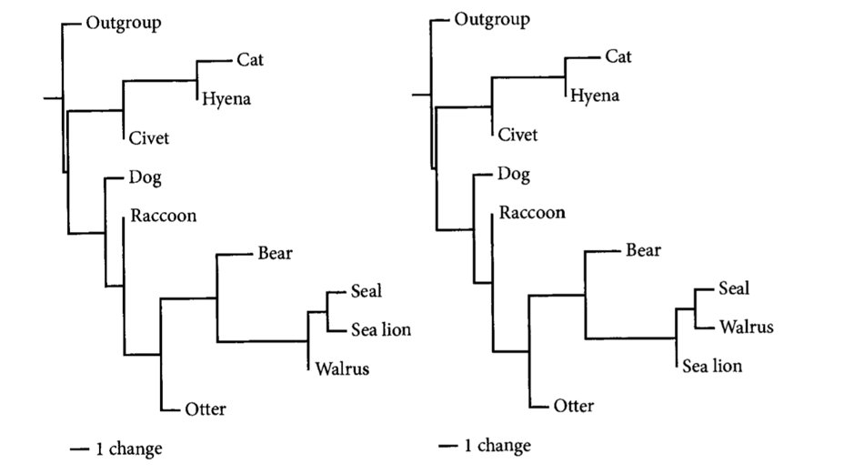
Support values
For distance, parsimony, and likelihood approaches
Every tree is an estimate. So we need a way to know how confident we should be in that estimate. We have the best tree, according to some criterion, but it is much better than the next best tree, etc?
Topology tests (how much better is the best tree that contains a clade than the best tree that doesn’t?) (Doesn’t work for distance methods)
(Nonparametric) bootstrapping
How is this done? (What is a bootstrap dataset?)
How is bootstrapping information summarized/used? (Consensus tree..)
Image from Tree Thinking

Slide 21
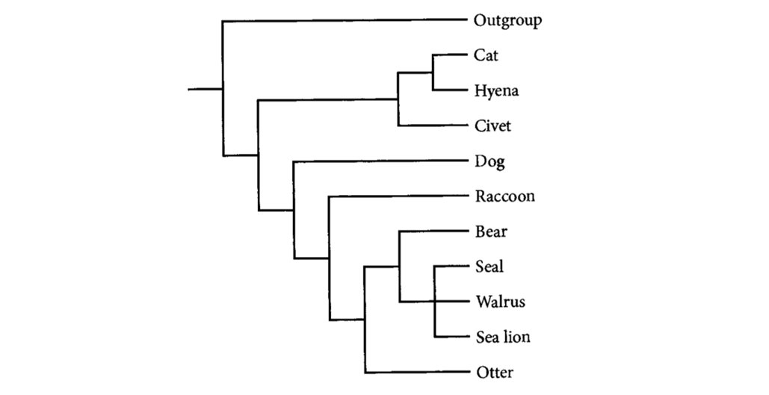
Support values
For distance, parsimony, and likelihood approaches
Every tree is an estimate. So we need a way to know how confident we should be in that estimate. We have the best tree, according to some criterion, but it is much better than the next best tree, etc?
Topology tests (how much better is the best tree that contains a clade than the best tree that doesn’t?) (Doesn’t work for distance methods)
(Nonparametric) bootstrapping
How is this done? (What is a bootstrap dataset?)
How is bootstrapping information summarized/used? (Consensus tree..)
Image from Tree Thinking

Slide 22
Support values
For distance, parsimony, and likelihood approaches
Every tree is an estimate. So we need a way to know how confident we should be in that estimate. We have the best tree, according to some criterion, but it is much better than the next best tree, etc?
Parametric bootstrapping
How is this done? (How does it differ from nonparametric bootstrapping?)

Slide 23
Support values
For Bayesian inference
We get support values for “free”!
Differences between posterior probabilities and bootstrap percentages
Bayesian topology tests

Slide 24
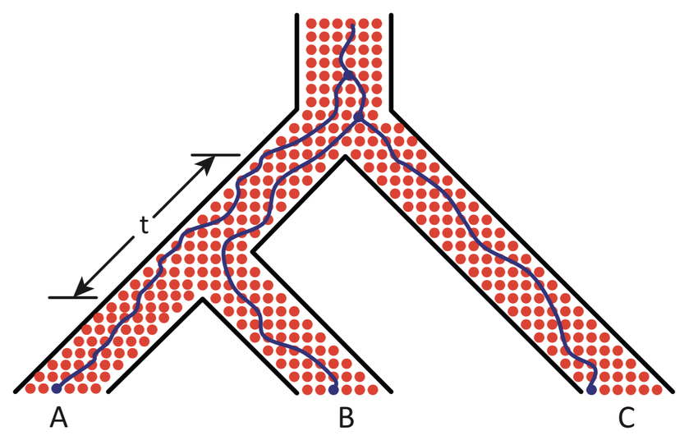
Incomplete lineage sorting
…and the coalescent
Even under a simple branching process (no hybridization, horizontal gene transfer, etc.) there is no guarantee that a given gene genealogy (“gene tree”) matches the species tree within which that geneology was “generated”
The true gene tree (no estimate error) may not match the tree species tree
If we sample another individual (another allele), it may have a different history
If we sample another locus for the same individual, it may have a different history
Image from Haber 2019 in
Philosophy Theory and Practice in Biology

Slide 25
Incomplete lineage sorting
…and the coalescent
Even under a simple branching process (no hybridization, horizontal gene transfer, etc.) there is no guarantee that a given gene genealogy (“gene tree”) matches the species tree within which that geneology was “generated”
The true gene tree (no estimation error) may not match the tree species tree
If we sample another individual (another allele), it may have a different history
If we sample another locus for the same individual, it may have a different history
Image from Haber 2019 in
Philosophy Theory and Practice in Biology

Slide 26
Incomplete lineage sorting
…and the coalescent
Even under a simple branching process (no hybridization, horizontal gene transfer, etc.) there is no guarantee that a given gene genealogy (“gene tree”) matches the species tree within which that geneology was “generated”
The true gene tree (no estimation error) may not match the tree species tree
If we sample another individual (another allele), it may have a different history
If we sample another locus for the same individual, it may have a different history
Image from Haber 2019 in
Philosophy Theory and Practice in Biology

Slide 27
Incomplete lineage sorting
…and the coalescent
Even under a simple branching process (no hybridization, horizontal gene transfer, etc.) there is no guarantee that a given gene genealogy (“gene tree”) matches the species tree within which that geneology was “generated”
The true gene tree (no estimation error) may not match the tree species tree
If we sample another individual (another allele), it may have a different history
If we sample another locus for the same individual, it may have a different history
Image from Haber 2019 in
Philosophy Theory and Practice in Biology

Slide 28
Incomplete lineage sorting
…and the coalescent
The probability of a gene tree not matching the species tree depends on the length of the branch over which the lineages may (or may not) coalesce (t in this diagram) and the population size (six in this diagram)
Implications:
If we use a coalescent model, we can estimate the species tree (including the t’s and the population sizes) from a set of gene trees (or directly from the data)
What are the implications of the coalescent for inferring a phylogeny of multiple individuals of a single species?
Image from Haber 2019 in
Philosophy Theory and Practice in Biology

Slide 29
Incomplete lineage sorting
…and the coalescent
The probability of a gene tree not matching the species tree depends on the length of the branch over which the lineages may (or may not) coalesce (t in this diagram) and the population size (six in this diagram)
Implications:
If we use a coalescent model, we can estimate the species tree (including the t’s and the population sizes) from a set of gene trees (or directly from the data)
What are the implications of the coalescent for inferring a phylogeny of multiple individuals of a single species?
Image from Haber 2019 in
Philosophy Theory and Practice in Biology

Slide 30
Incomplete lineage sorting
…and the coalescent
The probability of a gene tree not matching the species tree depends on the length of the branch over which the lineages may (or may not) coalesce (t in this diagram) and the population size (six in this diagram)
Implications:
If we use a coalescent model, we can estimate the species tree (including the t’s and the population sizes) from a set of gene trees (or directly from the data)
What are the implications of the coalescent for inferring a phylogeny of multiple individuals of a single species?
Image from Haber 2019 in
Philosophy Theory and Practice in Biology

Slide 31
The multispecies coalescent
Slides courtesy of Will Freyman

Slide 32
Divergence-time estimation
The dark art of

Slide 33
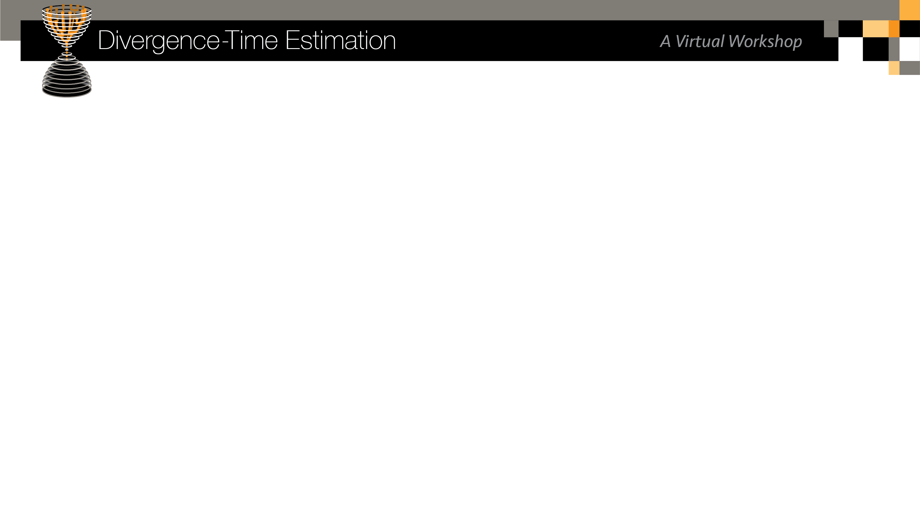
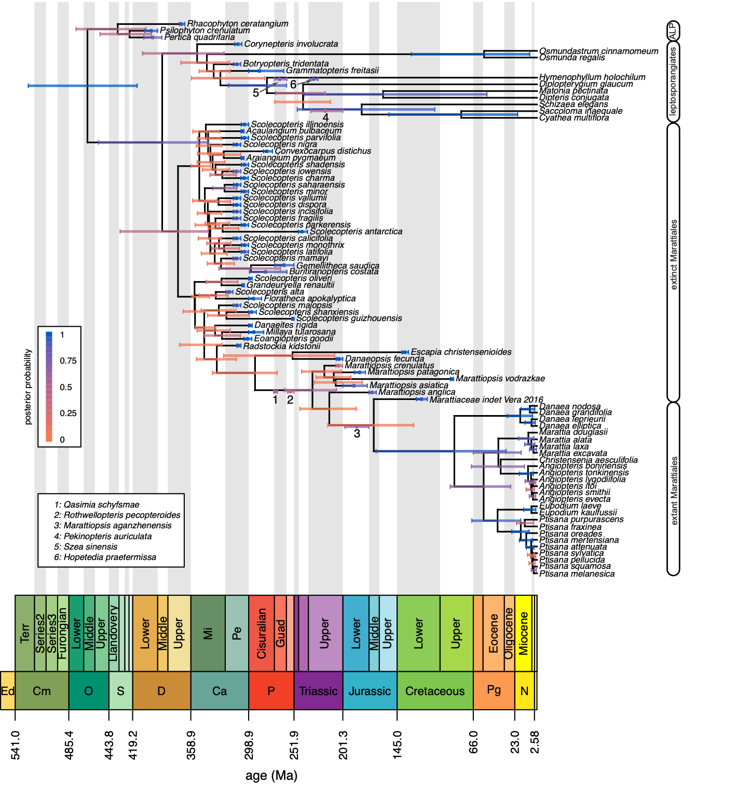
Divergence-time estimation
what we’re going to do today
May et al. 2021. Inferring the total-evidence timescale of marattialean fern evolution in the face of model sensitivity

Slide 34
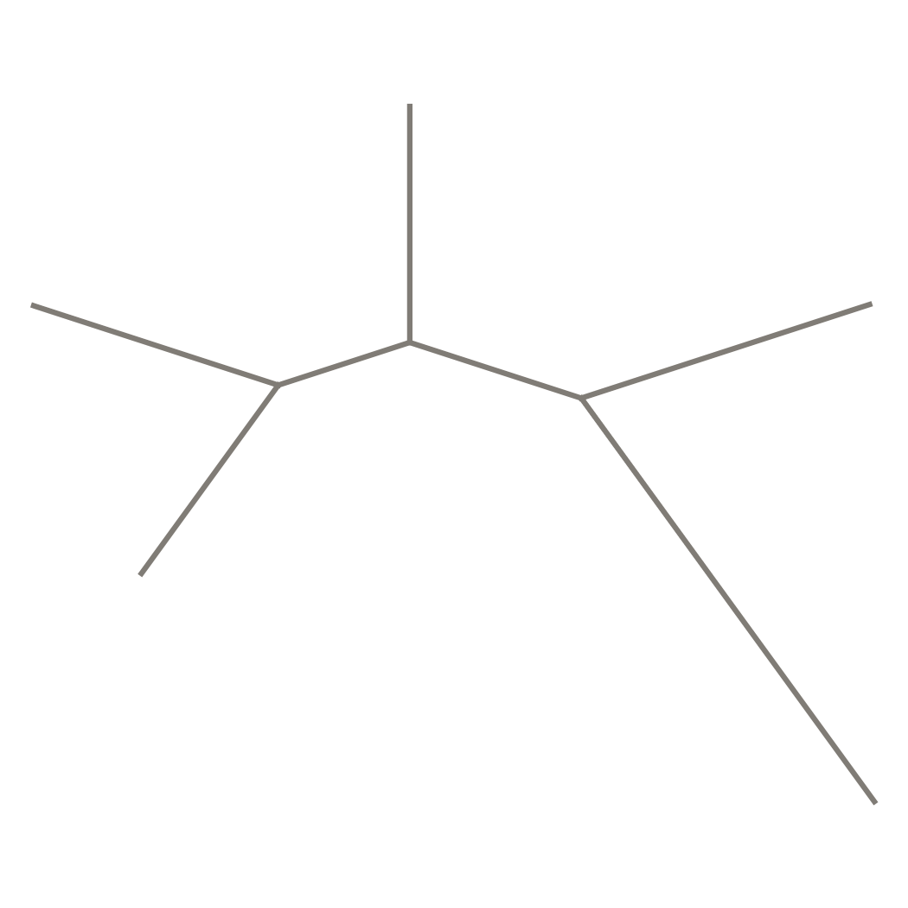
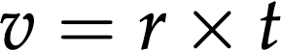
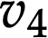
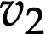
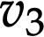
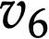
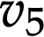
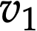
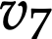
Phylograms versus chronograms
what is divergence-time estimation?
In a “standard” phylogenetic analysis, the tree is a phylogram: the branches are measured in expected number of substitutions per site (denoted v).
B
A
D
C
E

Slide 35
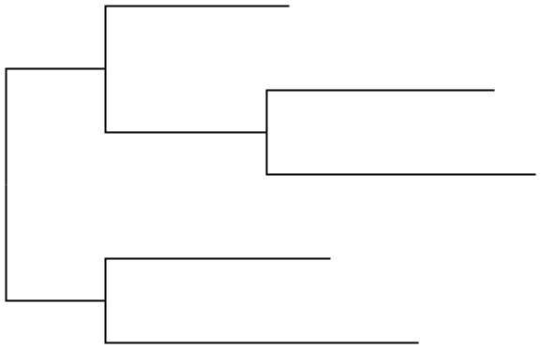
Phylograms versus chronograms
what is divergence-time estimation?
In a “standard” phylogenetic analysis, the tree is a phylogram: the branches are measured in expected number of substitutions per site (denoted v).
B
B
/2
A
D
C
A
C
D
/2
E
E

Slide 36
Phylograms versus chronograms
what is divergence-time estimation?
In a “standard” phylogenetic analysis, the tree is a phylogram: the branches are measured in expected number of substitutions per site (denoted v).
B
B
/2
A
D
C
A
C
D
/2
E
E
The curse of figtree

Slide 37
Phylograms versus chronograms
what is divergence-time estimation?
In a “standard” phylogenetic analysis, the tree is a phylogram: the branches are measured in expected number of substitutions per site (denoted v).
B
B
/2
A
D
C
A
C
D
/2
E
E

Slide 38
Non-identifiability of rate and time
why is this so hard?
Because the thing that is estimated—the branch lengths in expected number of substitutions per site, v—is the product of rate and time, molecular data cannot be used to estimate rate and time separately.
B
B
/2
A
D
C
A
C
D
/2
E
E

Slide 39
Non-identifiability of rate and time
why is this so hard?
Because the thing that is estimated—the branch lengths in expected number of substitutions per site, v—is the product of rate and time, molecular data cannot be used to estimate rate and time separately.
B
/2
C
A
D
/2
E

Slide 40
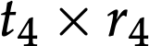
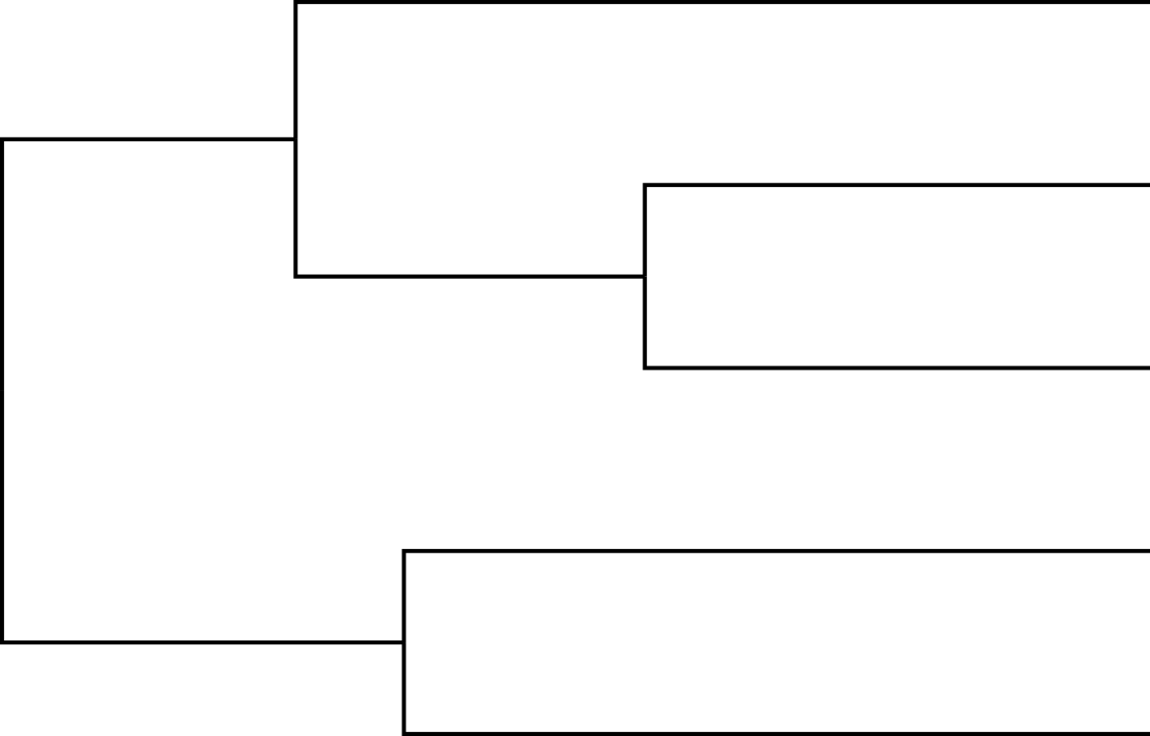
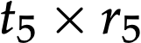
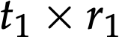
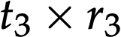
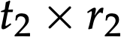
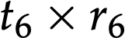
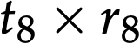
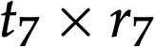
Non-identifiability of rate and time
why is this so hard?
Because the thing that is estimated—the branch lengths in expected number of substitutions per site, v—is the product of rate and time, molecular data cannot be used to estimate rate and time separately.
B
B
/2
C
C
A
A
D
D
/2
E
E
For a given branch, you can, e.g., double the rate and halve the duration (time), and get the exact same probability of the data (likelihood) as you would if left the branch in its original state.

Slide 41
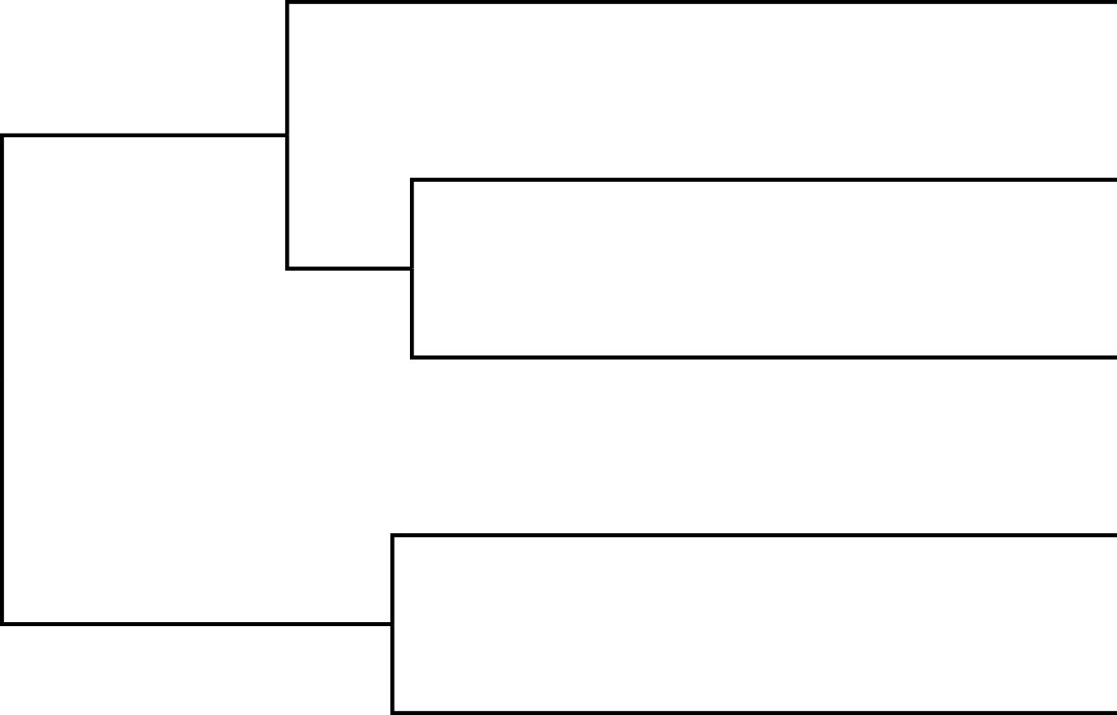
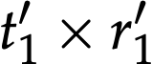
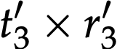
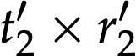
Non-identifiability of rate and time
why is this so hard?
Because the thing that is estimated—the branch lengths in expected number of substitutions per site, v—is the product of rate and time, molecular data cannot be used to estimate rate and time separately.
B
B
/2
C
C
A
A
D
D
/2
E
E
For a given branch, you can, e.g., double the rate and halve the duration (time), and get the exact same probability of the data (likelihood) as you would if left the branch in its original state.

Slide 42
Non-identifiability of rate and time
why is this so hard?
Because rate and time are non-identifiable from molecular data:
One cannot use maximum likelihood for divergence-time estimation (penalized likelihood approaches, such as in r8s or the R function chronos rely on a prior-like “smoothing parameter” and so are sort-of Bayesian)
In a Bayesian framework, the disentanglement of rate and time (to get relative divergence times) comes from the model (the likelihood of any of a set of rate/time combinations is the same, so it’s only the prior that distinguishes among them), not from the data, so these analyses are very “model-sensitive” aka “prior-sensitive”
This is a very different situation than typical for Bayesian analyses, where we’re used to being able to overwhelm the prior with informative data. No amount of (sequence) data can overwhelm the model, because sequence data only give us v, and infinite combinations of different durations and rates result in any given v
/2
/2

Slide 43
Non-identifiability of rate and time
why is this so hard?
Because rate and time are non-identifiable from molecular data:
One cannot use maximum likelihood for divergence-time estimation (penalized likelihood approaches, such as in r8s or the R function chronos rely on a prior-like “smoothing parameter” and so are sort-of Bayesian)
In a Bayesian framework, the disentanglement of rate and time (to get relative divergence times) comes from the model (the likelihood of any of a set of rate/time combinations is the same, so it’s only the prior that distinguishes among them), not from the data, so these analyses are very “model-sensitive” aka “prior-sensitive”
This is a very different situation than typical for Bayesian analyses, where we’re used to being able to overwhelm the prior with informative data. No amount of (sequence) data can overwhelm the model, because sequence data only give us v, and infinite combinations of different durations and rates result in any given v
/2
/2

Slide 44
Non-identifiability of rate and time
why is this so hard?
Because rate and time are non-identifiable from molecular data:
One cannot use maximum likelihood for divergence-time estimation (penalized likelihood approaches, such as in r8s or the R function chronos rely on a prior-like “smoothing parameter” and so are sort-of Bayesian)
In a Bayesian framework, the disentanglement of rate and time (to get relative divergence times) comes from the model (the likelihood of any of a set of rate/time combinations is the same, so it’s only the prior that distinguishes among them), not from the data, so these analyses are very “model-sensitive” aka “prior-sensitive”
This is a very different situation than typical for Bayesian analyses, where we’re used to being able to overwhelm the prior with informative data. No amount of (sequence) data can overwhelm the model, because sequence data only give us v, and infinite combinations of different durations and rates result in any given v
/2
/2

Slide 45
Non-identifiability of rate and time
why is this so hard?
Because rate and time are non-identifiable from molecular data:
One cannot use maximum likelihood for divergence-time estimation (penalized likelihood approaches, such as in r8s or the R function chronos rely on a prior-like “smoothing parameter” and so are sort-of Bayesian)
In a Bayesian framework, the disentanglement of rate and time (to get relative divergence times) comes from the model (the likelihood of any of a set of rate/time combinations is the same, so it’s only the prior that distinguishes among them), not from the data, so these analyses are very “model-sensitive” aka “prior-sensitive”
This is a very different situation than typical for Bayesian analyses, where we’re used to being able to overwhelm the prior with informative data. No amount of (sequence) data can overwhelm the model, because sequence data only give us v, and infinite combinations of different durations and rates result in any given v
/2
/2

Slide 46
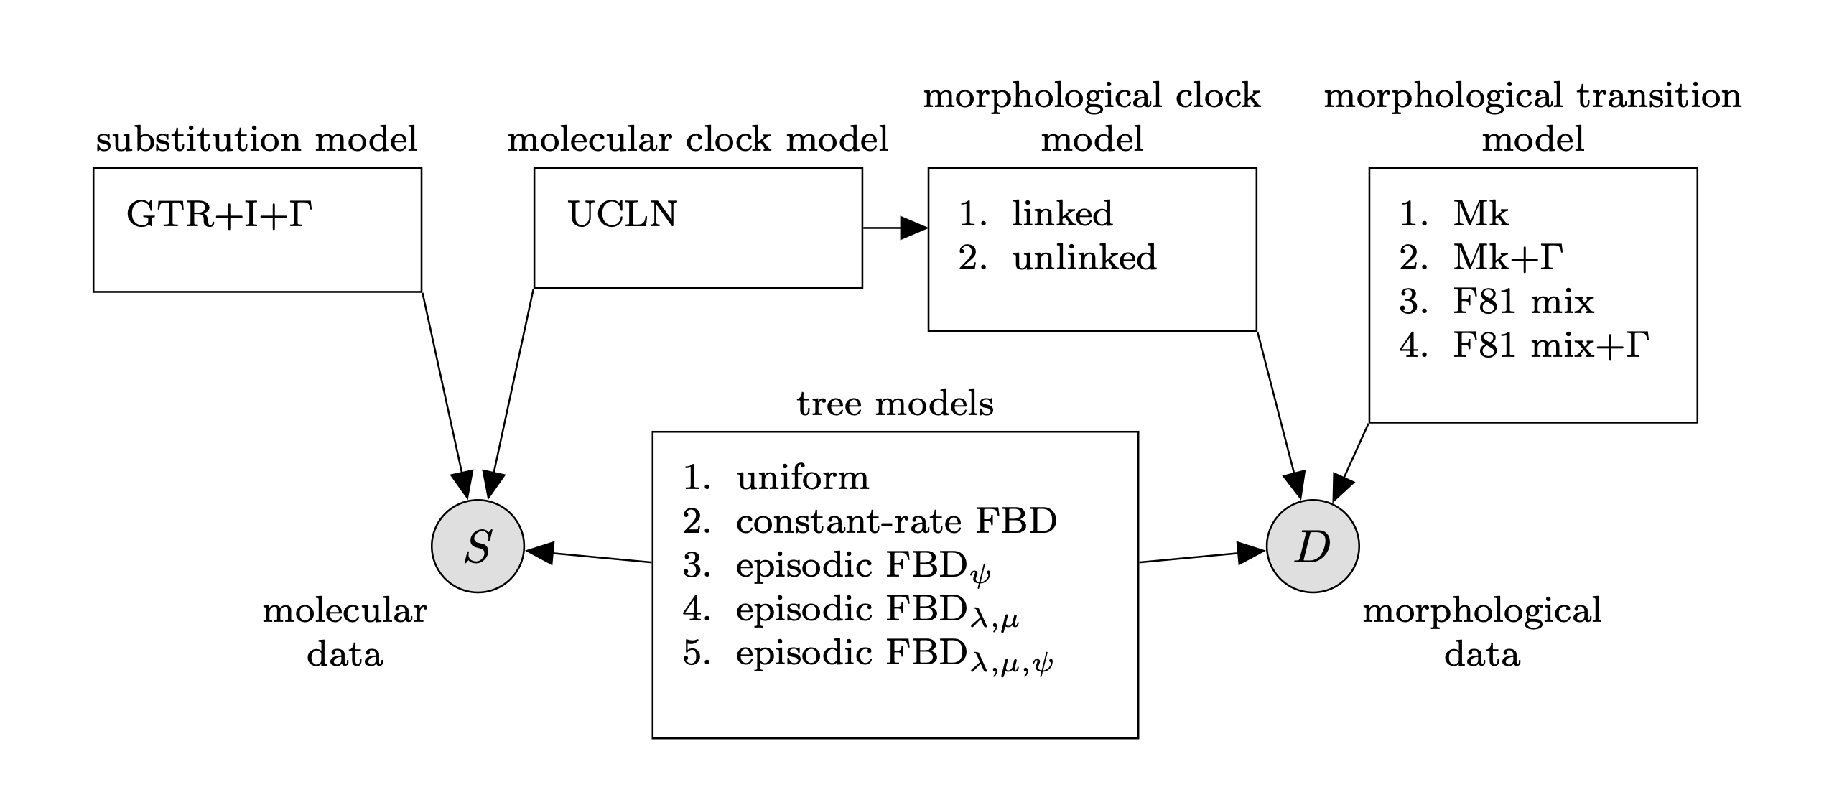
Disentangling rate and time
“sensitive” to which models?
Disentangling rate and time is accomplished by models that describe the evolution of rate (clock models) and by models that describe the distribution of lineage durations (tree models)
May et al. 2021. Inferring the total-evidence timescale of marattialean fern evolution in the face of model sensitivity

Slide 47
Clock models
models of rates of evolution
Clock models (with their associated priors) are models that describe how rates of evolution (substitution rates, or rates of change of morphological characters) vary across the tree. Such models are necessary to get the “r” part of t x r

Slide 48
Clock models
models of rates of evolution
Clock models (with their associated priors) are models that describe how rates of evolution (substitution rates, or rates of change of morphological characters) vary across the tree. Such models are necessary to get the “r” part of t x r
The simplest clock model is called a strict clock, and has a single rate parameter for the whole tree

Slide 49
Clock models
models of rates of evolution
Clock models (with their associated priors) are models that describe how rates of evolution (substitution rates, or rates of change of morphological characters) vary across the tree. Such models are necessary to get the “r” part of t x r
The simplest clock model is called a strict clock, and has a single rate parameter for the whole tree
The assumption of a single rate can be relaxed, hence relaxed clock models

Slide 50
Clock models
models of rates of evolution
Clock models (with their associated priors) are models that describe how rates of evolution (substitution rates, or rates of change of morphological characters) vary across the tree. Such models are necessary to get the “r” part of t x r
The simplest clock model is called a strict clock, and has a single rate parameter for the whole tree
The assumption of a single rate can be relaxed, hence relaxed clock models
Relaxed clocks have two main flavors:
Autocorrelated clock models, where there is phylogenetic structure to the rates (there is a tendency for child branches to have similar rates to their ancestor branch)
Uncorrelated clock models, where rates for each branch are individually sampled from a distribution, and thus there’s no correlation between parent and child branches

Slide 51
Clock models
models of rates of evolution
Autocorrelated clock models are arguably more biologically sensible (in that we expect rate to be driven by organismal characteristics that themselves evolve) but are often computationally very difficult to run
Random local clock model: The tree is divided into pieces, each of which has its own clock rate, and the number of pieces, break points between pieces, and the rates for each piece are inferred.
“General” autocorrelated clock model: The rate of each child branch is drawn from a distribution related to the parent branch’s value
Uncorrelated clock models, where rates for each branch are individually sampled from a distribution, and thus there’s no correlation between parent and child branches. There are two versions in common use
Lognormal relaxed clock: Rates are sampled from a lognormal distribution, the mean of which is estimated from the data
Exponential relaxed clock: Rates are sampled from an exponential distribution, the mean of which is estimated from the data

Slide 52
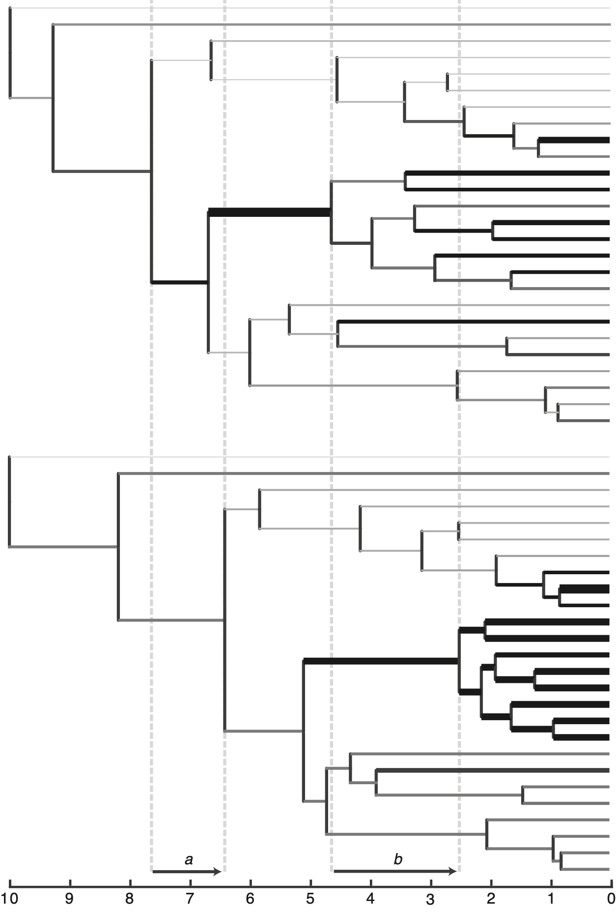
Clock models
models of rates of evolution
The clock model can have a very strong influence on the inferred divergence times. The two trees to the right are inferred using identical data (sequence alignments) and the same model of evolution (substitution model, etc), except:
The clock model for the top tree is an uncorrelated lognormal relaxed clock
The clock model for the bottom tree is a random local clock
In both trees, the branches are thickened in proportion to the inferred substitution rate, r.
Rothfels & Schuettpelz 2014. Accelerated rate of molecular evolution for vittarioid ferns is strong and not driven by selection
arbitrary units before the present

Slide 53
tree models
models of trees (lineage durations)
Tree models (with their associated priors) are models that describe how trees evolve. If you simulate under a tree model, you get a tree (including topology and branch lengths). If the tree model is such that it produces timetrees, it gives us the relative branch lengths—the “t” part of t x r
May et al. 2021. Inferring the total-evidence timescale of marattialean fern evolution in the face of model sensitivity

Slide 54
tree models
models of trees (lineage durations)
Tree models (with their associated priors) are models that describe how trees evolve. If you simulate under a tree model, you get a tree (including topology and branch lengths). If the tree model is such that it produces timetrees, it gives us the relative branch lengths—the “t” part of t x r
The uniform timetree model, as it is usually conceived, attempts to make each timetree equally likely, but has some pathological behavior, especially when the number of tips increases
May et al. 2021. Inferring the total-evidence timescale of marattialean fern evolution in the face of model sensitivity

Slide 55
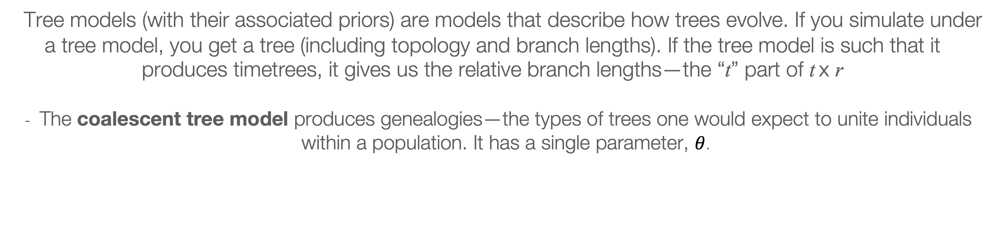
tree models
models of trees (lineage durations)
Tree models (with their associated priors) are models that describe how trees evolve. If you simulate under a tree model, you get a tree (including topology and branch lengths). If the tree model is such that it produces timetrees, it gives us the relative branch lengths—the “t” part of t x r
The coalescent tree model produces genealogies—the types of trees one would expect to unite individuals within a population. It has a single parameter, $θ$.

Slide 56
tree models
models of trees (lineage durations)
Tree models (with their associated priors) are models that describe how trees evolve. If you simulate under a tree model, you get a tree (including topology and branch lengths). If the tree model is such that it produces timetrees, it gives us the relative branch lengths—the “t” part of t x r
The birth-death tree model produces trees where each lineage has a given instantaneous probability of forming a new lineage (speciating) or going extinct; if the extinction rate is set to zero, this is called a pure-birth or “Yule” model. A full birth-death model has two parameters—one each for the extinction and speciation rates.

Slide 57
tree models
models of trees (lineage durations)
Tree models (with their associated priors) are models that describe how trees evolve. If you simulate under a tree model, you get a tree (including topology and branch lengths). If the tree model is such that it produces timetrees, it gives us the relative branch lengths—the “t” part of t x r
The fossilized birth-death tree model produces trees where each lineage has a given instantaneous probability of forming a new lineage (speciating), going extinct, or leaving a fossil

Slide 58
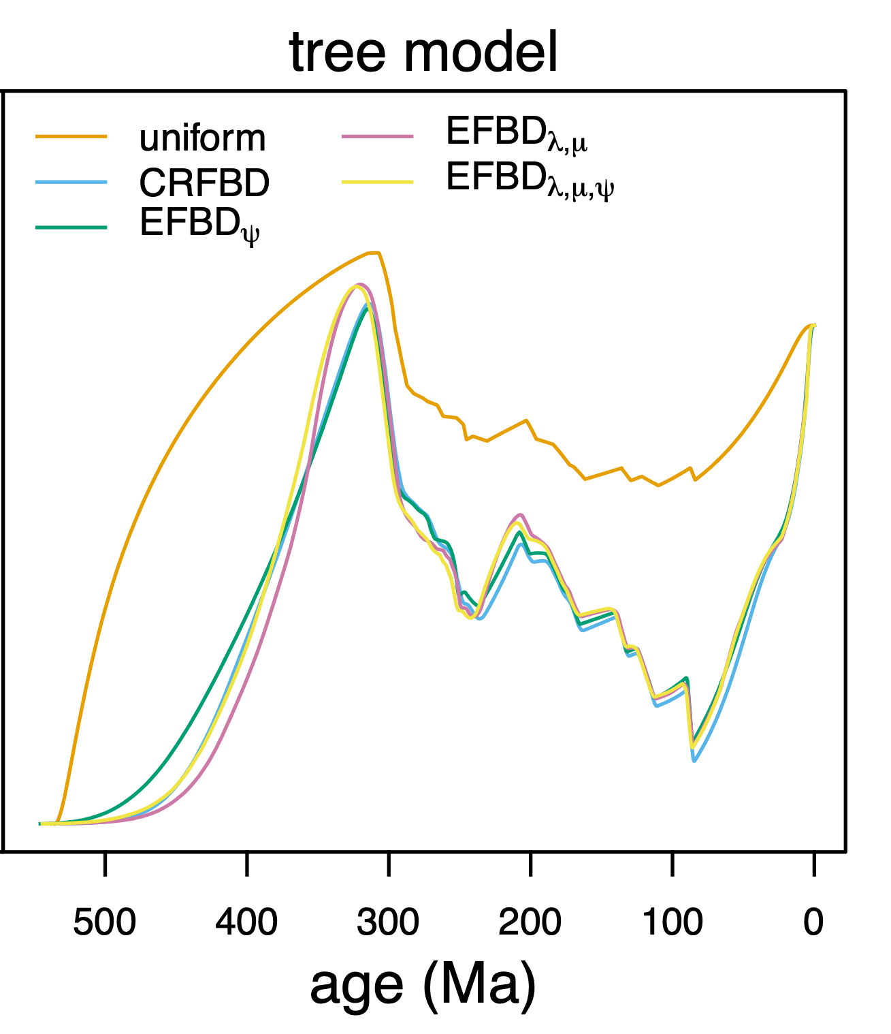
tree models
models of trees (lineage durations)
The tree model can have a very strong influence on the inferred divergence times. The plot on the right shows the median number of lineages inferred to exist at each time point, for divergence-time estimation analyses under four different tree models (the data—including a rich sample of fossils—and all other model components are kept identical).
The “FBD” tree models are based on the fossilized birth-death process
May et al. 2021. Inferring the total-evidence timescale of marattialean fern evolution in the face of model sensitivity

Slide 59
getting absolute time
sources of temporal information
Together, a clock model and a tree model allow us to infer the rate and duration (time) of each branch, and thus to infer a tree with relative divergence times.

Slide 60
getting absolute time
sources of temporal information
Together, a clock model and a tree model allow us to infer the rate and duration (time) of each branch, and thus to infer a tree with relative divergence times. To get absolute times, we need a source of temporal data.

Slide 61
getting absolute time
sources of temporal information
Together, a clock model and a tree model allow us to infer the rate and duration (time) of each branch, and thus to infer a tree with relative divergence times. To get absolute times, we need a source of temporal data.
One option would be to place a prior on the average rate of, say, molecular evolution. Because rates vary a lot, especially between groups, this approach is not commonly taken (and to get the rate in the first place you probably had to do divergence-time estimation..)

Slide 62
getting absolute time
sources of temporal information
Together, a clock model and a tree model allow us to infer the rate and duration (time) of each branch, and thus to infer a tree with relative divergence times. To get absolute times, we need a source of temporal data.
One option would be to place a prior on the average rate of, say, molecular evolution. Because rates vary a lot, especially between groups, this approach is not commonly taken (and to get the rate in the first place you probably had to do divergence-time estimation..)
The second option, which we’ll concentrate on, is to place a prior on time, with the temporal data typically coming from the fossil record

Slide 63
getting absolute time
node dating
The main way that fossil data have been incorporated in divergence-time estimation is the approach that we now typically refer to as node dating.

Slide 64
getting absolute time
node dating
The main way that fossil data have been incorporated in divergence-time estimation is the approach that we now typically refer to as node dating.
Node dating remains the dominant approach to divergence-time estimation, but two flavors of tip dating—total-evidence dating and tip dating under the fossilized birth-death process—are becoming more popular.
But first, node dating…

Slide 65
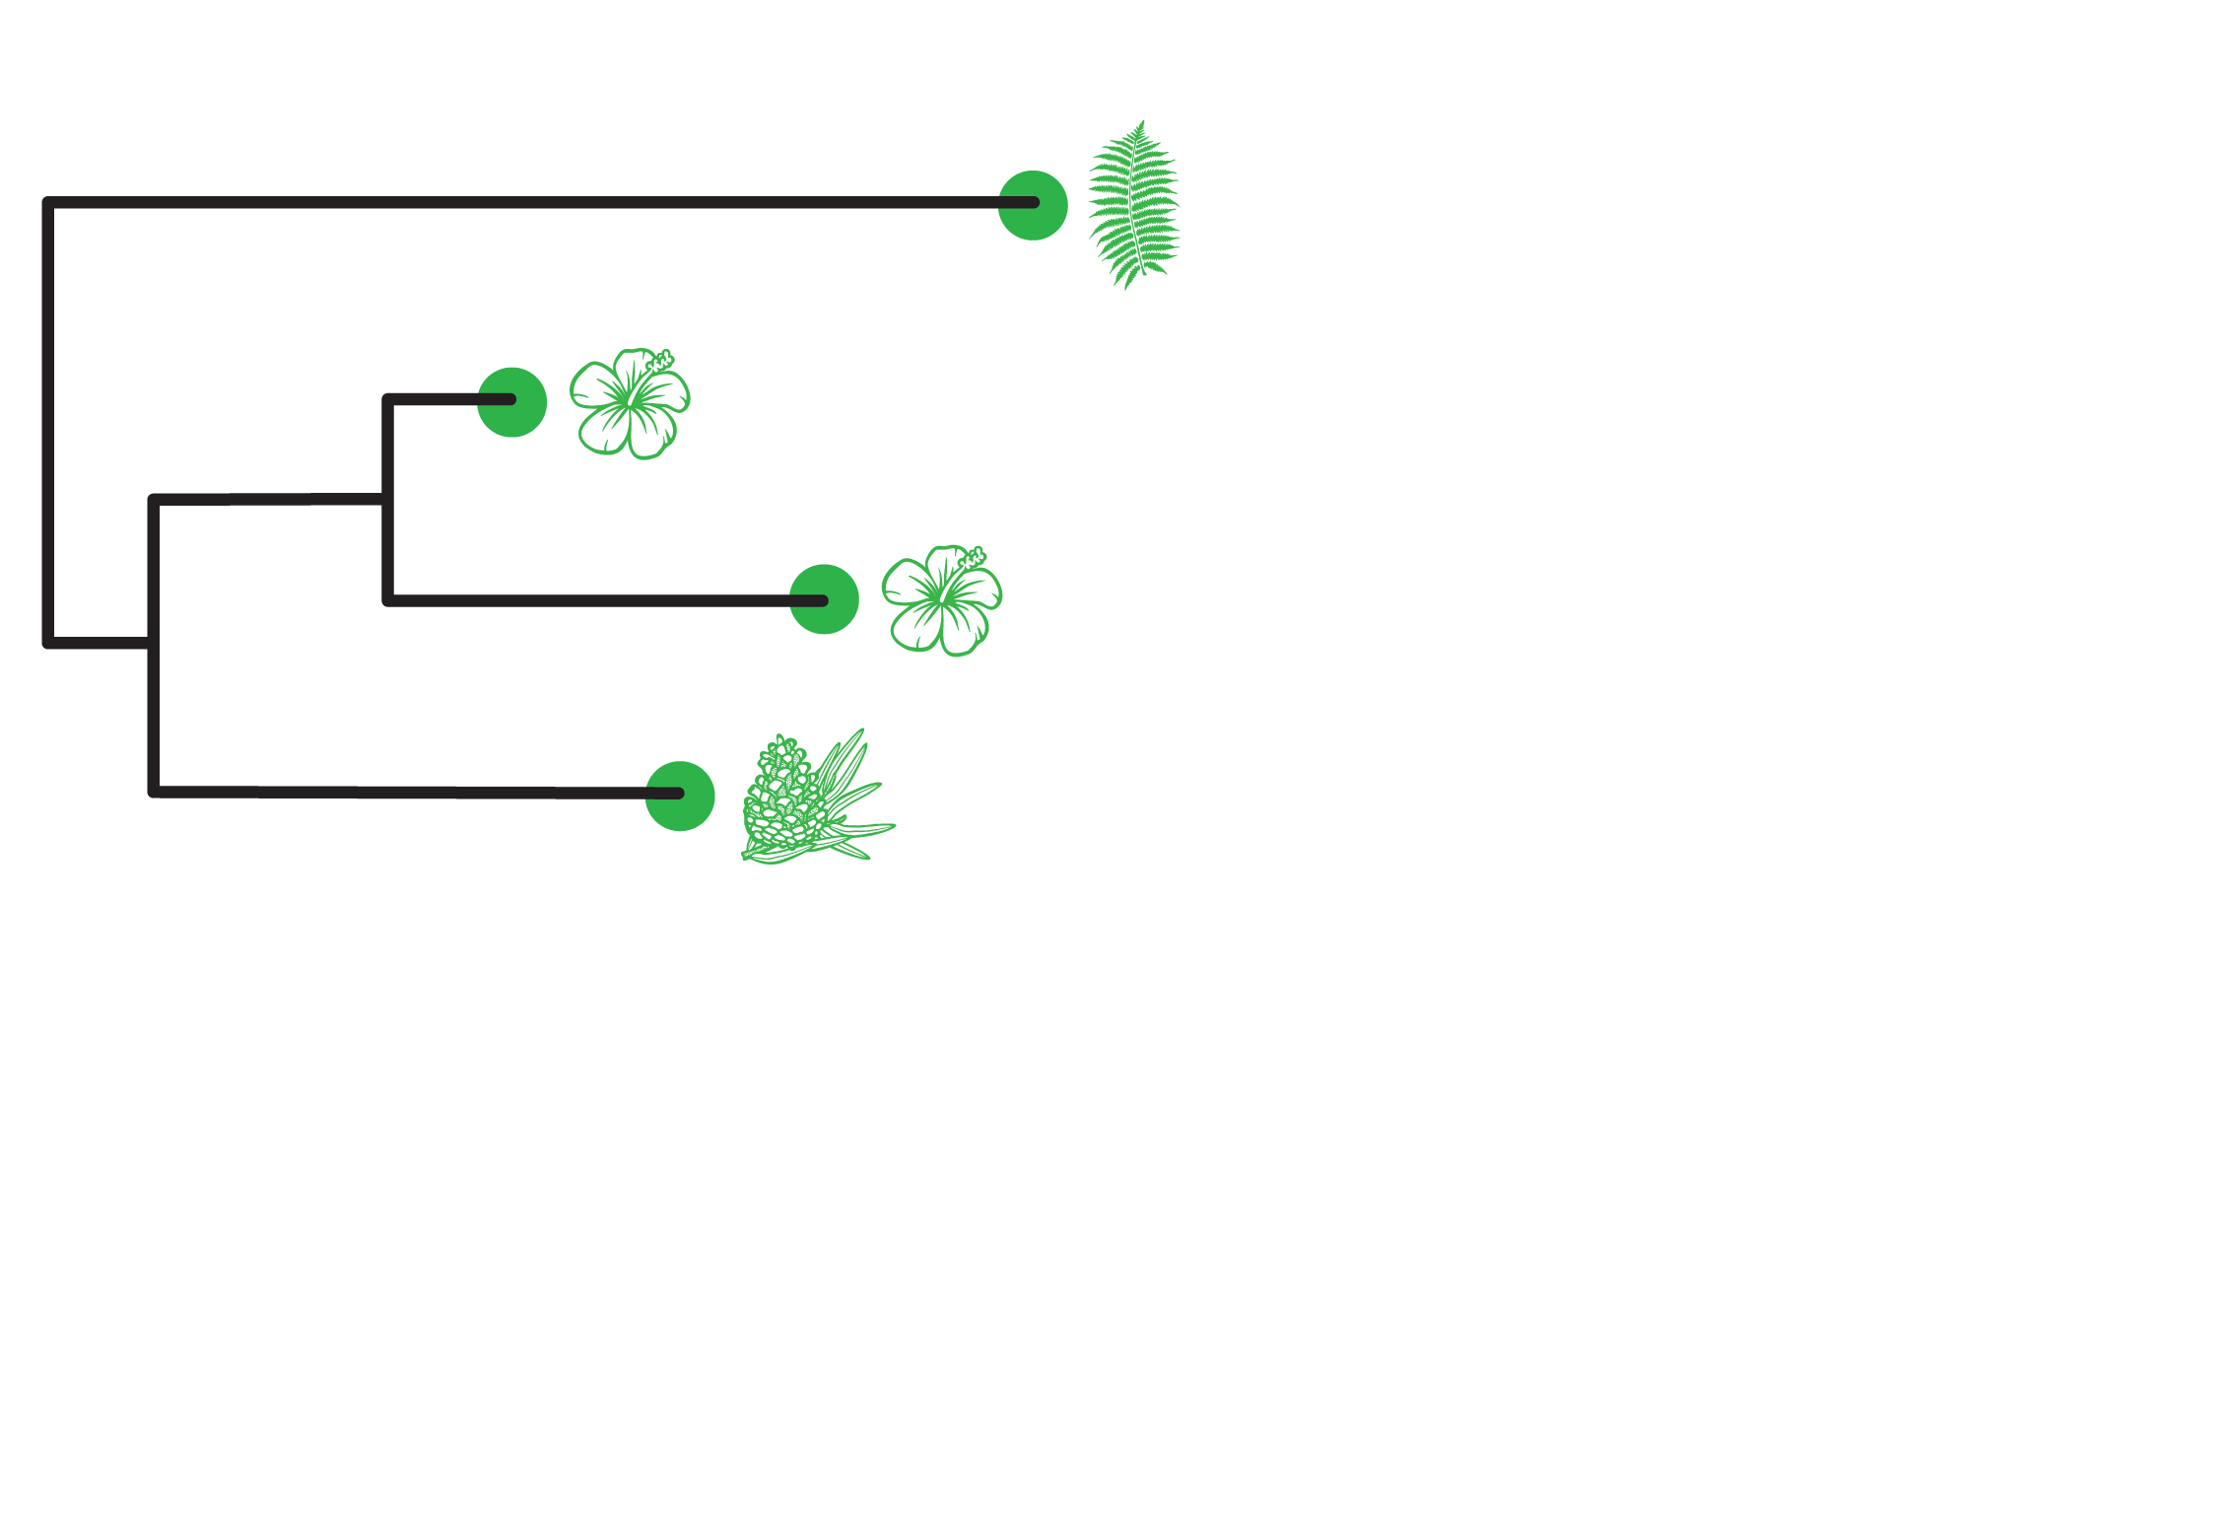
getting absolute time
node dating
We have a group of accessions, and we can infer their phylogeny using “standard” approaches.
But this gives us branch lengths in units of expected number of substitutions per site, rather than in time.

Slide 66
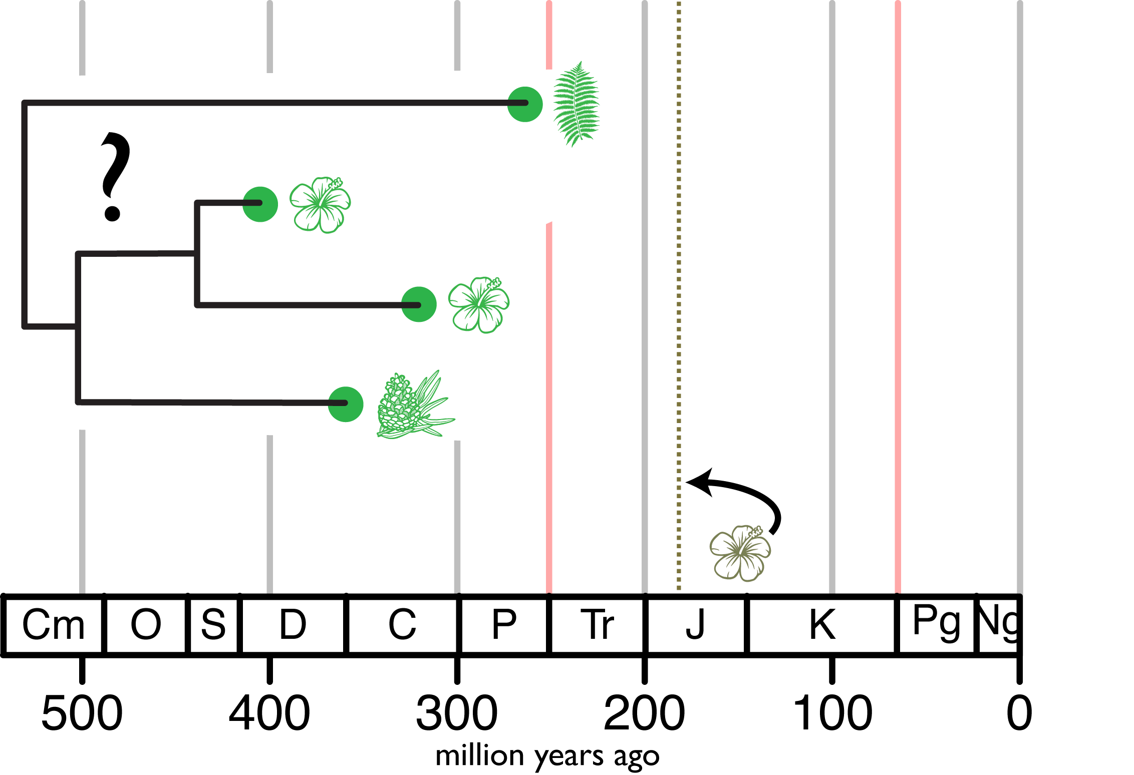
getting absolute time
node dating
We have a group of accessions, and we can infer their phylogeny using “standard” approaches.
But this gives us branch lengths in units of expected number of substitutions per site, rather than in time. To get absolute time, we have one fossil available.

Slide 67
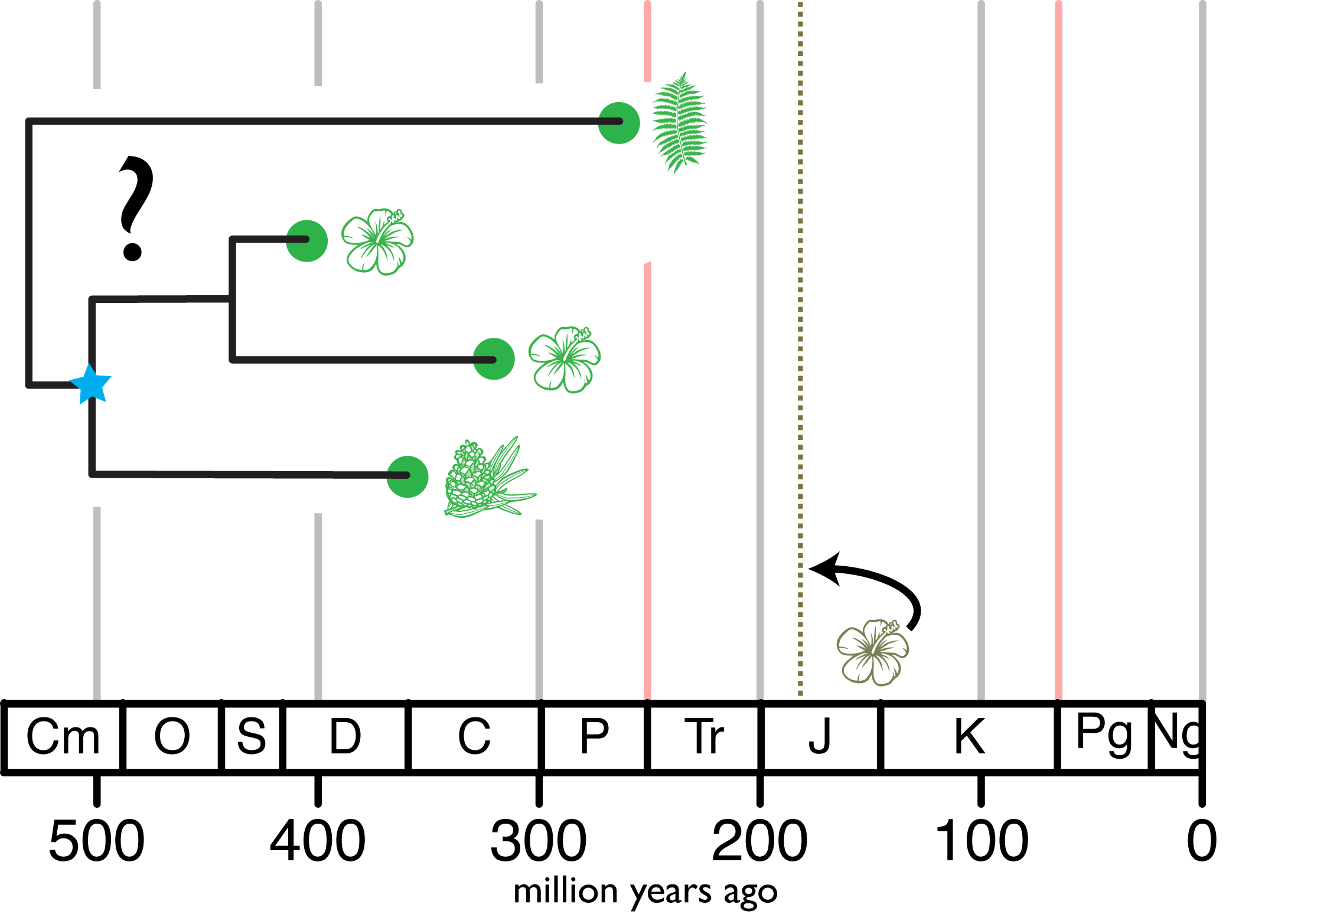
getting absolute time
node dating
We have a group of accessions, and we can infer their phylogeny using “standard” approaches.
But this gives us branch lengths in units of expected number of substitutions per site, rather than in time. To get absolute time, we have one fossil available.
If we know what group the fossil belongs to, then we know that the stem age of that group has to be at least as old as the fossil…

Slide 68
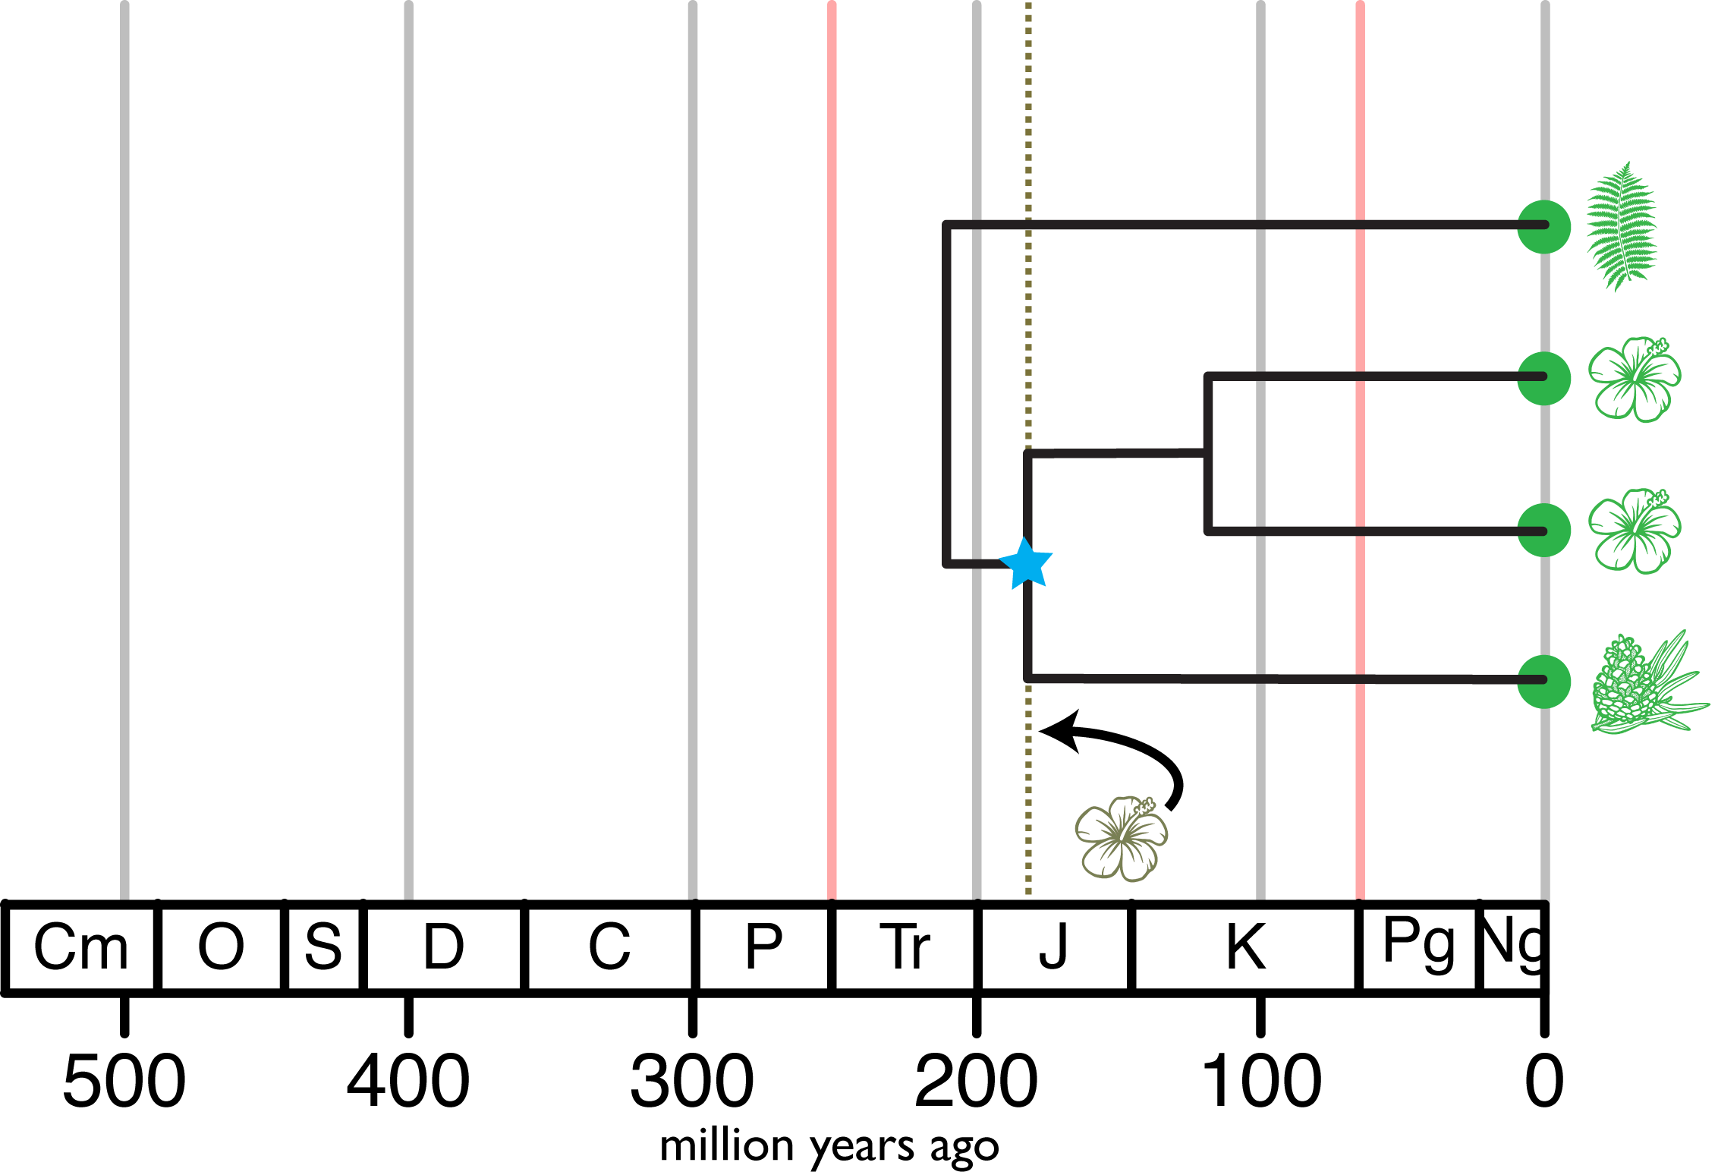
getting absolute time
node dating
We have a group of accessions, and we can infer their phylogeny using “standard” approaches.
But this gives us branch lengths in units of expected number of substitutions per site, rather than in time. To get absolute time, we have one fossil available.
If we know what group the fossil belongs to, then we know that the stem age of that group has to be at least as old as the fossil, which gives us an absolute time, and our clock and tree models can give us the relative times (the rest of the divergences).

Slide 69
getting absolute time
node dating
We have a group of accessions, and we can infer their phylogeny using “standard” approaches.
But this gives us branch lengths in units of expected number of substitutions per site, rather than in time. To get absolute time, we have one fossil available.
If we know what group the fossil belongs to, then we know that the stem age of that group has to be at least as old as the fossil, which gives us an absolute time, and our clock and tree models can give us the relative times (the rest of the divergences).
But did the characters that define that group evolve immediately after its divergence from its closest sampled relative? And also that lineage was immediately fossilized, and ultimately recovered and described by paleontologists?

Slide 70
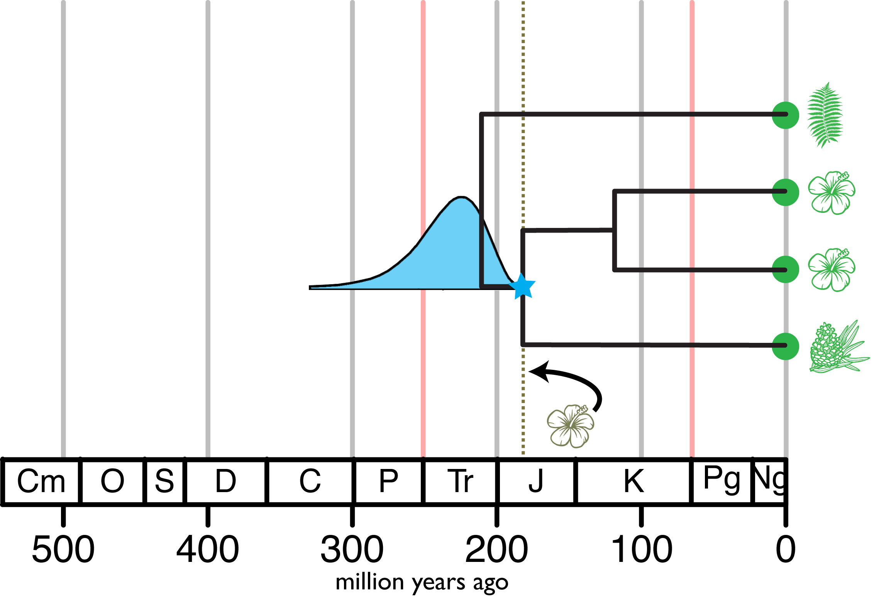
getting absolute time
node dating
We have a group of accessions, and we can infer their phylogeny using “standard” approaches.
But this gives us branch lengths in units of expected number of substitutions per site, rather than in time. To get absolute time, we have one fossil available.
If we know what group the fossil belongs to, then we know that the stem age of that group has to be at least as old as the fossil, which gives us an absolute time, and our clock and tree models can give us the relative times (the rest of the divergences).
But did the characters that define that group evolve immediately after its divergence from its closest sampled relative? And also that lineage was immediately fossilized, and ultimately recovered and described by paleontologists?

Slide 71
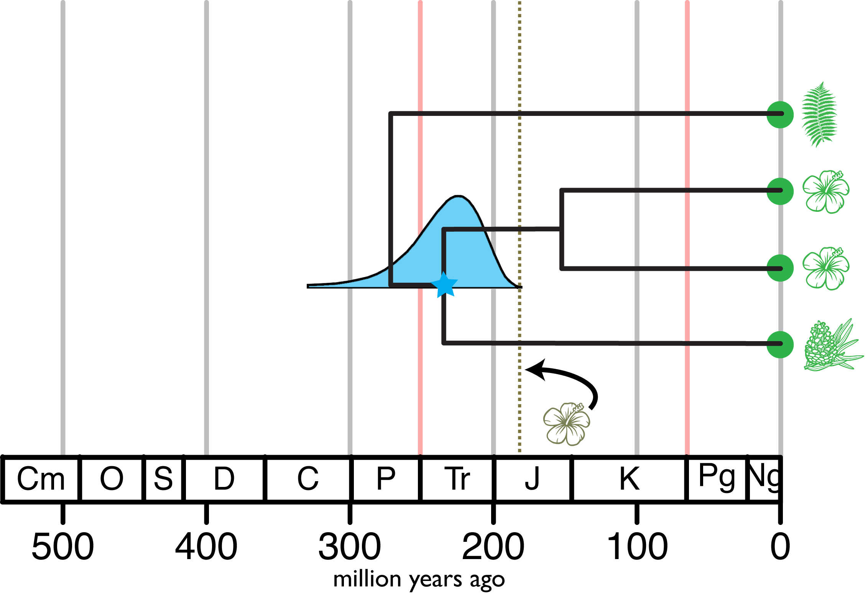
getting absolute time
node dating
We have a group of accessions, and we can infer their phylogeny using “standard” approaches.
But this gives us branch lengths in units of expected number of substitutions per site, rather than in time. To get absolute time, we have one fossil available.
If we know what group the fossil belongs to, then we know that the stem age of that group has to be at least as old as the fossil, which gives us an absolute time, and our clock and tree models can give us the relative times (the rest of the divergences).
But did the characters that define that group evolve immediately after its divergence from its closest sampled relative? And also that lineage was immediately fossilized, and ultimately recovered and described by paleontologists?

Slide 72

getting absolute time
node dating
We have a group of accessions, and we can infer their phylogeny using “standard” approaches.
But this gives us branch lengths in units of expected number of substitutions per site, rather than in time. To get absolute time, we have one fossil available.
If we know what group the fossil belongs to, then we know that the stem age of that group has to be at least as old as the fossil, which gives us an absolute time, and our clock and tree models can give us the relative times (the rest of the divergences).
But did the characters that define that group evolve immediately after its divergence from its closest sampled relative? And also that lineage was immediately fossilized, and ultimately recovered and described by paleontologists?

Slide 73
getting absolute time
node dating
This node-dating approach has a series of drawbacks:

Slide 74
getting absolute time
node dating
This node-dating approach has a series of drawbacks:
Each fossil has to be assigned to a particular node in the tree (so the options are limited)

Slide 75
getting absolute time
node dating
This node-dating approach has a series of drawbacks:
Each fossil has to be assigned to a particular node in the tree (so the options are limited)
Only the oldest fossil assigned to a particular node is of any use*
*but see Marshall 2008, 2019 for ways that information from other fossils can be incorporated

Slide 76
getting absolute time
node dating
This node-dating approach has a series of drawbacks:
Each fossil has to be assigned to a particular node in the tree (so the options are limited)
Only the oldest fossil assigned to a particular node is of any use
The assignment of the fossil to the node is determined by the investigator, often based on implicit assumptions of morphological evolution

Slide 77
getting absolute time
node dating
This node-dating approach has a series of drawbacks:
Each fossil has to be assigned to a particular node in the tree (so the options are limited)
Only the oldest fossil assigned to a particular node is of any use
The assignment of the fossil to the node is determined by the investigator, often based on implicit assumptions of morphological evolution
The relationship between the fossil and the node (the type of calibration distribution to use) is also determined by the investigator, often based on implicit assumptions of morphological evolution and of the fossilization process

Slide 78
getting absolute time
node dating
These drawbacks of node dating are more critical than they otherwise would be due to the non-identifiability/model-sensitivity of divergence-time estimation, as discussed earlier.

Slide 79
getting absolute time
node dating
These drawbacks of node dating are more critical than they otherwise would be due to the non-identifiability/model-sensitivity of divergence-time estimation, as discussed earlier. Effectively, ALL of the divergence-time inference comes from the interaction of the tree model (constrained by the calibrating densities) and the clock model.

Slide 80
getting absolute time
node dating
These drawbacks of node dating are more critical than they otherwise would be due to the non-identifiability/model-sensitivity of divergence-time estimation, as discussed earlier. Effectively, ALL of the divergence-time inference comes from the interaction of the tree model (constrained by the calibrating densities) and the clock model.
No amount of sequence data can overcome the influence of these model components.

Slide 81
getting absolute time
node dating
These drawbacks of node dating are more critical than they otherwise would be due to the non-identifiability/model-sensitivity of divergence-time estimation, as discussed earlier. Effectively, ALL of the divergence-time inference comes from the interaction of the tree model (constrained by the calibrating densities) and the clock model.
No amount of sequence data can overcome the influence of these model components.
These model components are a priori assumptions (particularly the calibrating densities). They may be well-informed assumptions, but regardless, there is nothing in the analysis that can alert us if our assumptions are flawed.

Slide 82
Tree models: (fossilized) birth-death models
We can use the fossilized birth-death process to model to evolution of a tree with extinct and extant taxa.

Slide 83
Tree models: (fossilized) birth-death models
We can use the fossilized birth-death process to model to evolution of a tree with extinct and extant taxa.
Birth-death models are attractive because they have biologically interpretable parameters.

Slide 84

Tree models: (fossilized) birth-death models
We can use the fossilized birth-death process to model to evolution of a tree with extinct and extant taxa.
Birth-death models are attractive because they have biologically interpretable parameters.
$λ$ (speciation rate): the rate at which a lineage produces new lineages

Slide 85

Tree models: (fossilized) birth-death models
We can use the fossilized birth-death process to model to evolution of a tree with extinct and extant taxa.
Birth-death models are attractive because they have biologically interpretable parameters.
$λ$ (speciation rate): the rate at which a lineage produces new lineages
$μ$ (extinction rate): the rate at which a lineage goes extinct

Slide 86

Tree models: (fossilized) birth-death models
We can use the fossilized birth-death process to model to evolution of a tree with extinct and extant taxa.
Birth-death models are attractive because they have biologically interpretable parameters.
$λ$ (speciation rate): the rate at which a lineage produces new lineages
$μ$ (extinction rate): the rate at which a lineage goes extinct
$ψ$ (fossilization rate): the rate at which a lineage produces fossils (that are then recovered, described, etc…)

Slide 87

Tree models: (fossilized) birth-death models
We can use the fossilized birth-death process to model to evolution of a tree with extinct and extant taxa.
Birth-death models are attractive because they have biologically interpretable parameters.
$λ$ (speciation rate): the rate at which a lineage produces new lineages
$μ$ (extinction rate): the rate at which a lineage goes extinct
$ψ$ (fossilization rate): the rate at which a lineage produces fossils (that are then recovered, described, etc…)
$ρ$ (sampling fraction): the fraction of extant diversity that is included in the phylogeny

Slide 88

Tree models: (fossilized) birth-death models
The waiting time until an event is exponentially distributed.
P(waiting time)
waiting time

Slide 89

Tree models: (fossilized) birth-death models
What if there are multiple types of events?
P(waiting time)
waiting time

Slide 90

Tree models: (fossilized) birth-death models
The waiting time until the first event is exponential with rate $λ+μ+ψ$
P(waiting time)
P(waiting time)
waiting time
waiting time

Slide 91



Tree models: (fossilized) birth-death models
When the first event occurs, the probability that it is of a given type is relative the rate of each event.
speciation: $\frac{λ}{λ+μ+ψ}$
P(waiting time)
extinction: $\frac{μ}{λ+μ+ψ}$
fossilization: $\frac{ψ}{λ+μ+ψ}$
waiting time

Slide 92
Tree models: (fossilized) birth-death models
Let’s simulate a tree with this process.
We begin with a single lineage at time t in the past.
t
time (before present)
0

Slide 93
Tree models: (fossilized) birth-death models
Let’s simulate a tree with this process.
We begin with a single lineage at time t in the past.
We simulate an exponential waiting time…
t
time (before present)
0

Slide 94

Tree models: (fossilized) birth-death models
Let’s simulate a tree with this process.
We begin with a single lineage at time t in the past.
We simulate an exponential waiting time…
We choose the event…
speciation event
t
time (before present)
0

Slide 95
Tree models: (fossilized) birth-death models
Let’s simulate a tree with this process.
We begin with a single lineage at time t in the past.
We simulate an exponential waiting time…
We choose the event…
We simulate the next lineage…
speciation event
t
time (before present)
0

Slide 96

Tree models: (fossilized) birth-death models
Let’s simulate a tree with this process.
We begin with a single lineage at time t in the past.
We simulate an exponential waiting time…
We choose the event…
We simulate the next lineage…
We choose the event…
fossilization event
speciation event
t
time (before present)
0

Slide 97
Tree models: (fossilized) birth-death models
Let’s simulate a tree with this process.
We begin with a single lineage at time t in the past.
We simulate an exponential waiting time…
We choose the event…
We simulate the next lineage…
We choose the event…
And so forth, until we reach the present (or everyone goes extinct).
fossilization event
speciation event
t
time (before present)
0

Slide 98
Tree models: (fossilized) birth-death models
Let’s simulate a tree with this process.
We begin with a single lineage at time t in the past.
We simulate an exponential waiting time…
We choose the event…
We simulate the next lineage…
We choose the event…
And so forth, until we reach the present (or everyone goes extinct).
fossilization event
extinction event
speciation event
t
time (before present)
0

Slide 99

Tree models: (fossilized) birth-death models
Let’s simulate a tree with this process.
We begin with a single lineage at time t in the past.
We simulate an exponential waiting time…
We choose the event…
We simulate the next lineage…
We choose the event…
And so forth, until we reach the present (or everyone goes extinct).
fossilization event
extinction event
speciation event
t
time (before present)
0

Slide 100
Tree models: (fossilized) birth-death models
Let’s simulate a tree with this process.
We begin with a single lineage at time t in the past.
We simulate an exponential waiting time…
We choose the event…
We simulate the next lineage…
We choose the event…
And so forth, until we reach the present (or everyone goes extinct).
fossilization event
extinction event
speciation event
sampling event
t
time (before present)
0

Slide 101

Tree models: (fossilized) birth-death models
We then remove unsampled lineages, producing a “reconstructed” or “sampled” tree, $Ψ$, with fossil ages F.
t
time (before present)
0

Slide 102

Tree models: (fossilized) birth-death models
We then remove unsampled lineages, producing a “reconstructed” or “sampled” tree, $Ψ$, with fossil ages F.
Notice there can be sampled ancestors!
t
time (before present)
0

Slide 103

Tree models: (fossilized) birth-death models
We then remove unsampled lineages, producing a “reconstructed” or “sampled” tree, $Ψ$, with fossil ages F.
Notice there can be sampled ancestors!
We can compute the probability of this tree under a fossilized birth-death model.
t
time (before present)
0

Slide 104
Tree models: (fossilized) birth-death models
We then remove unsampled lineages, producing a “reconstructed” or “sampled” tree, $Ψ$, with fossil ages F.
Notice there can be sampled ancestors!
We can compute the probability of this tree under a fossilized birth-death model.

Slide 105

Tree models: (fossilized) birth-death models
We then remove unsampled lineages, producing a “reconstructed” or “sampled” tree, $Ψ$, with fossil ages F.
Notice there can be sampled ancestors!
We can compute the probability of this tree under a fossilized birth-death model.

